Slide 1

R for health data analysis

Slide 2
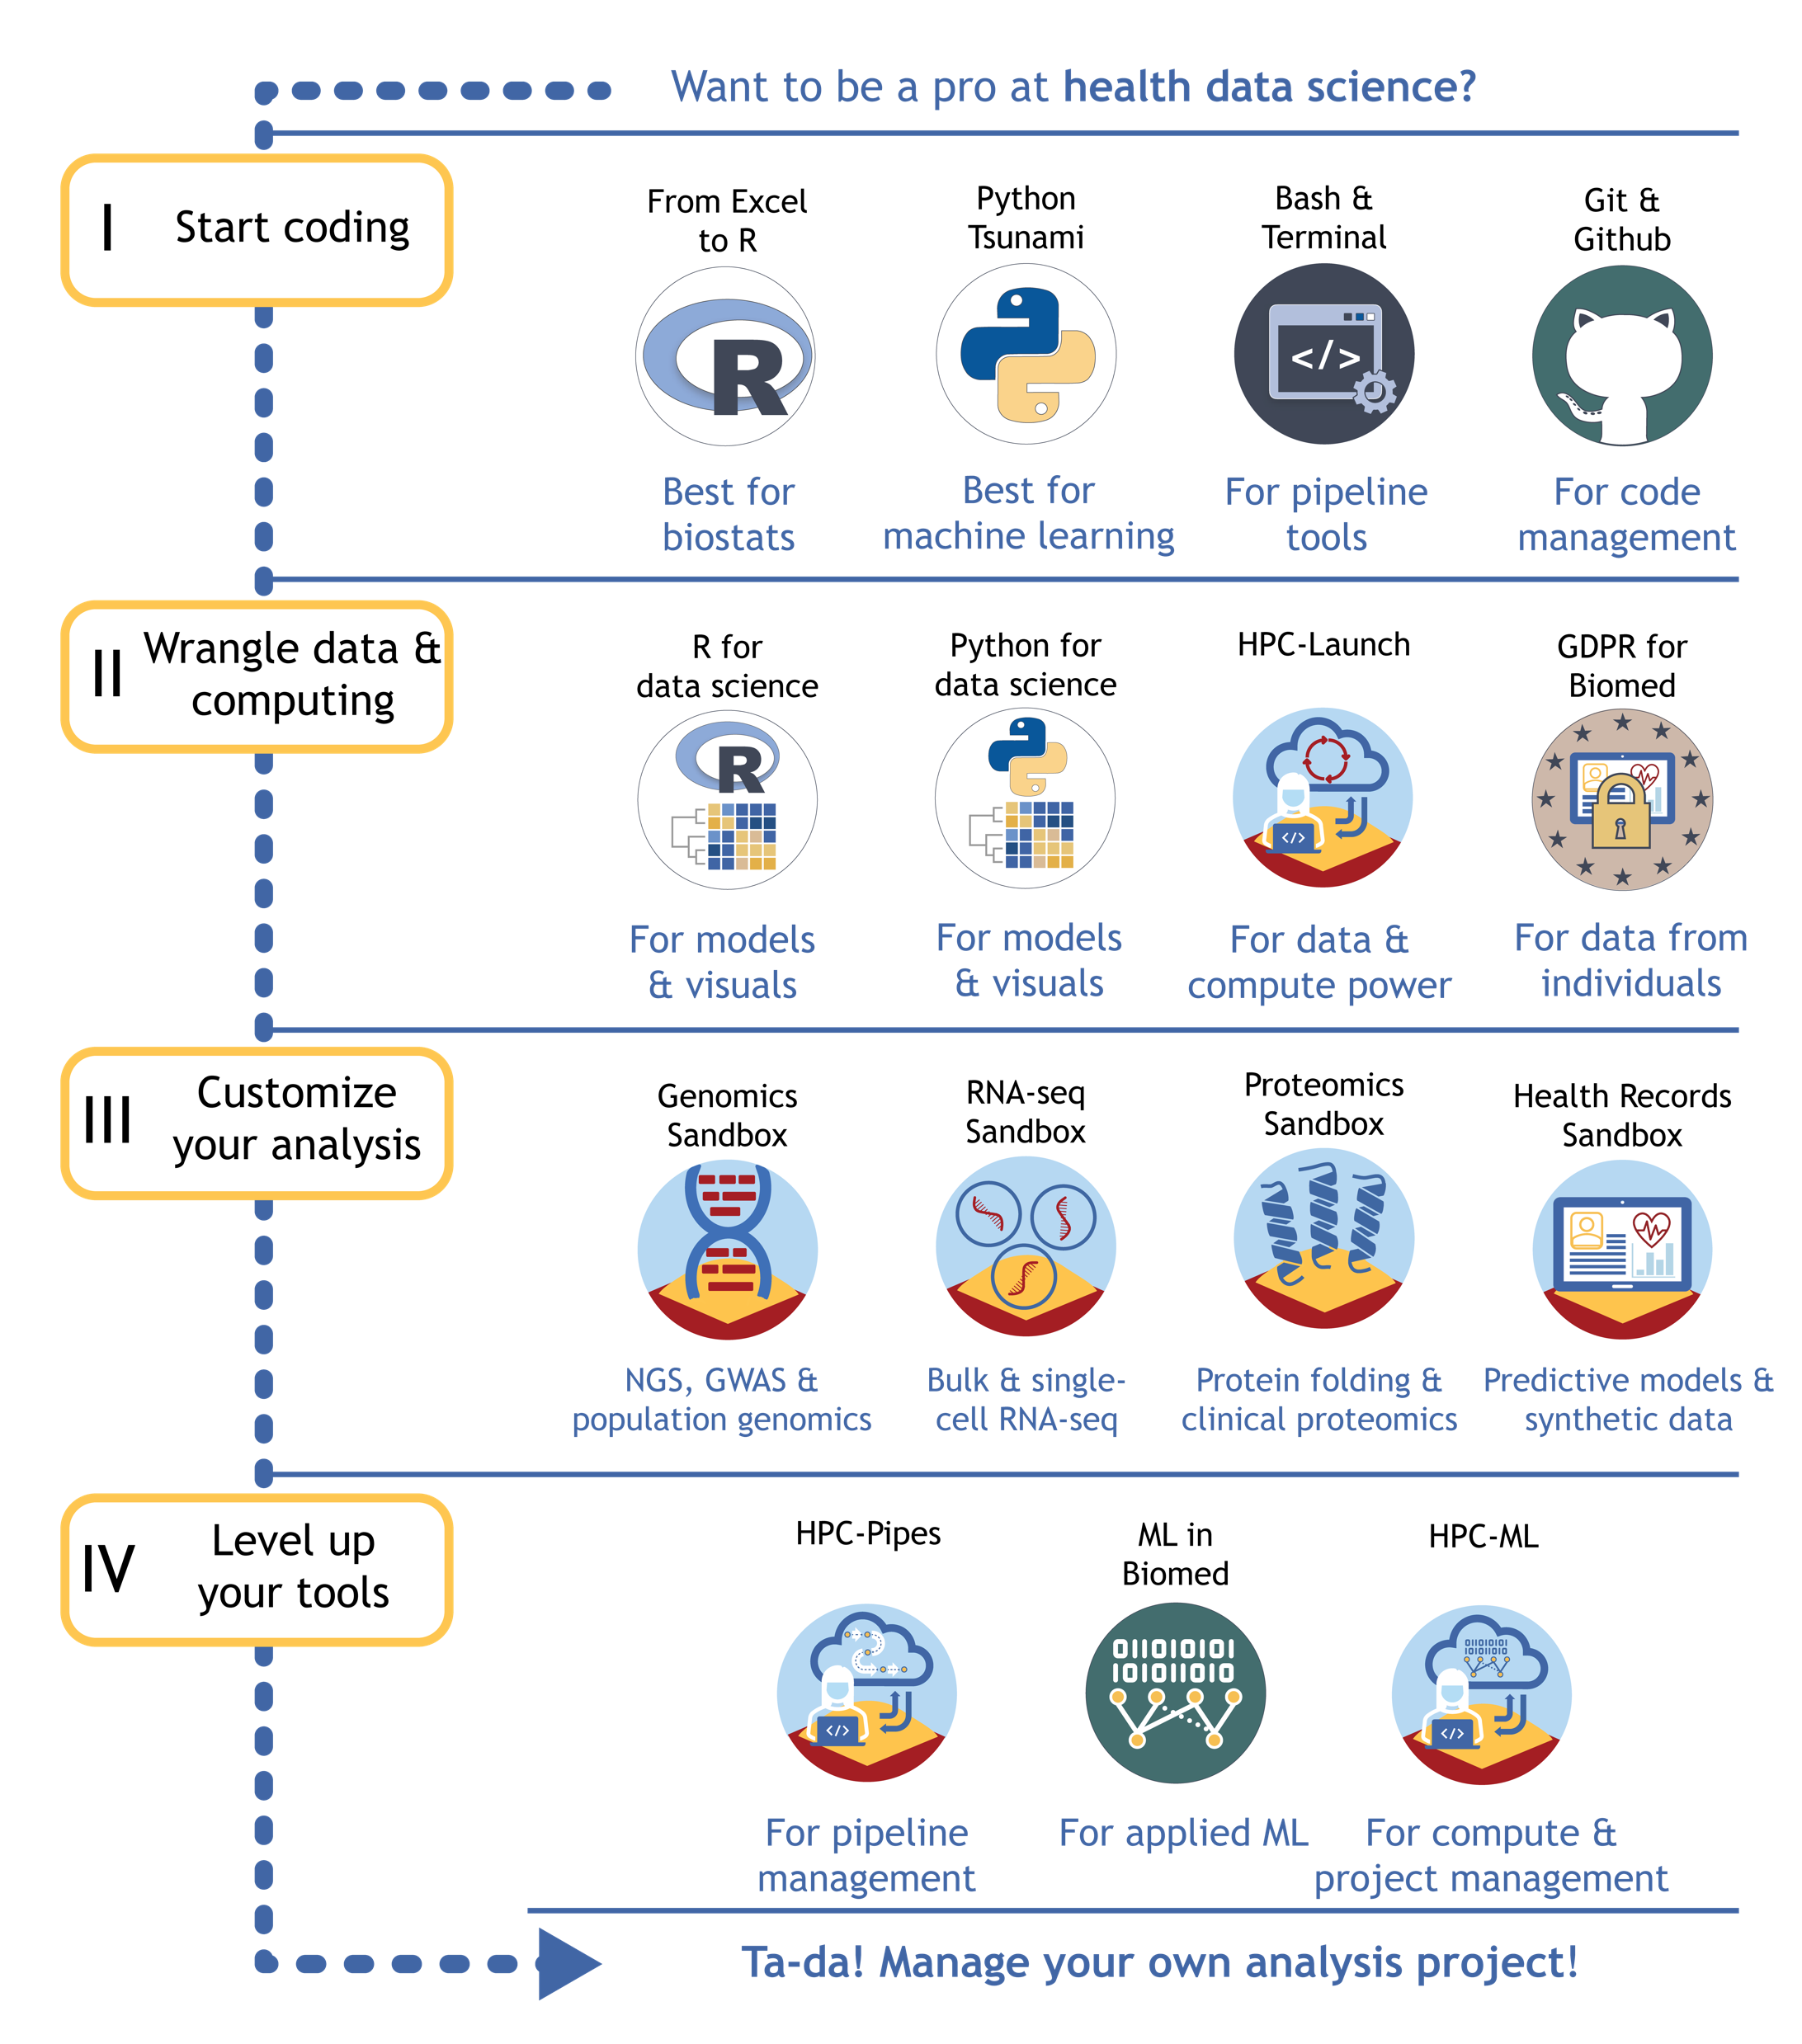

Who are we?
Training from KU’s Center for Health Data Science
Mikkel Werling, MS
Your TA for RealWorld
PhD trainee, Rigshospitalet
Health data scientist
Mikkel.werling@region.dk
Jennifer Bartell, PhD
Center for Health Data Science @ KU SUND Chefkonsulent
Sandbox manager & data scientist
bartell@sund.ku.dk

Slide 3
Agenda for today

Slide 4

Introductory poll
Experience with coding in R/RStudio?
Experience with working on servers or HPC platforms?
Experience with building models from health data?

Slide 5

What is high performance computing (HPC)?
Using a supercomputer or cluster of computers to perform jobs too computationally intensive for a personal computer
Quantum mechanics
Complex physical simulations (CFD)
Weather forecasting
Molecular modeling
Machine learning / LLMs

Slide 6



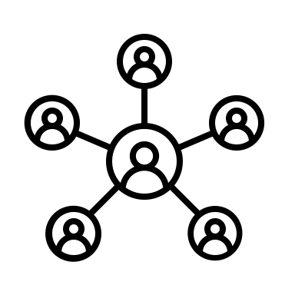


What is high performance computing (HPC)?
GPU-based tasks
Compute-heavy tasks
RAM-heavy tasks
Using a supercomputer or cluster of computers to perform jobs too computationally intensive for a personal computer
Quantum mechanics
Complex physical simulations (CFD)
Weather forecasting
Molecular modeling
Machine learning / LLMs
Data-heavy tasks
Safely shared tasks

Slide 7
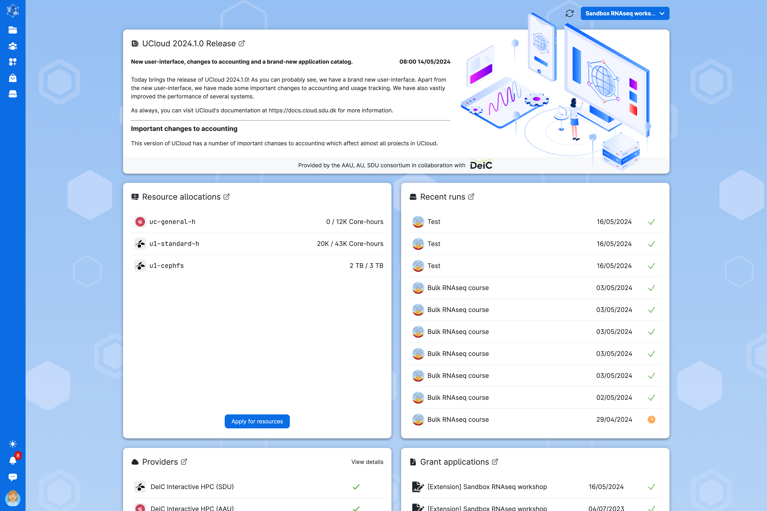
Interactive HPC with UCloud Central dashboard
Notes:
User Interface features a central dashboard and a navigation menu on the left wide that always remains visible. The user interface is designed to provide a user-friendly overview of UCloud resources.

Slide 8
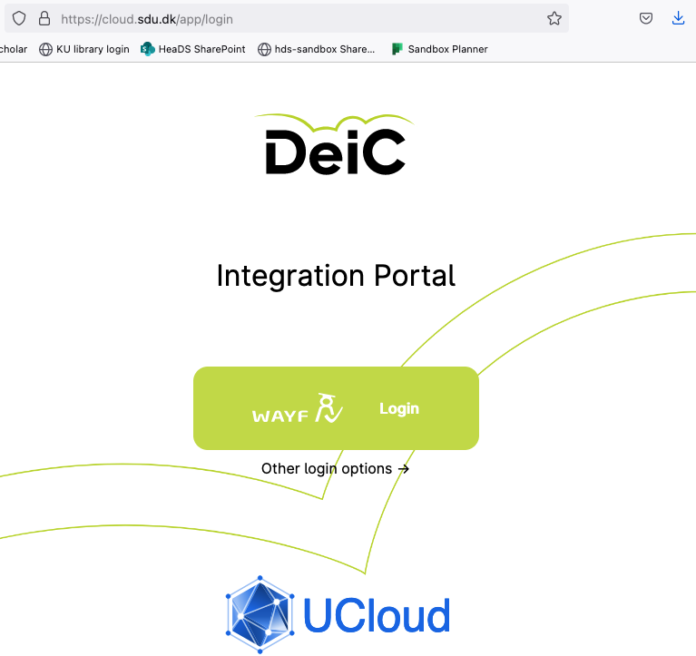
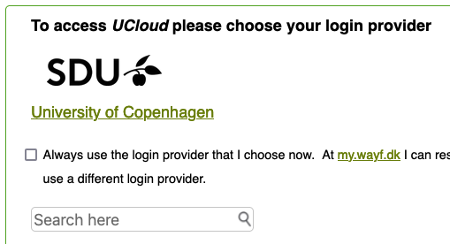

Interactive HPC with UCloud
1. Search & then click on link
2. Sign-in via KU portal

Slide 9
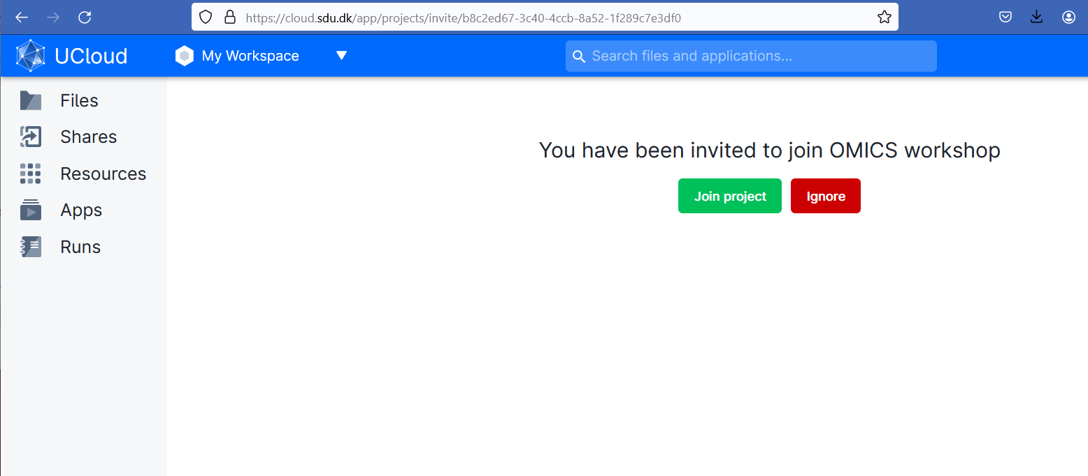
Interactive HPC with UCloud
You’ve been sent a UCloud project invite from From Realworld Data Til Personlig Medicin!

Slide 10
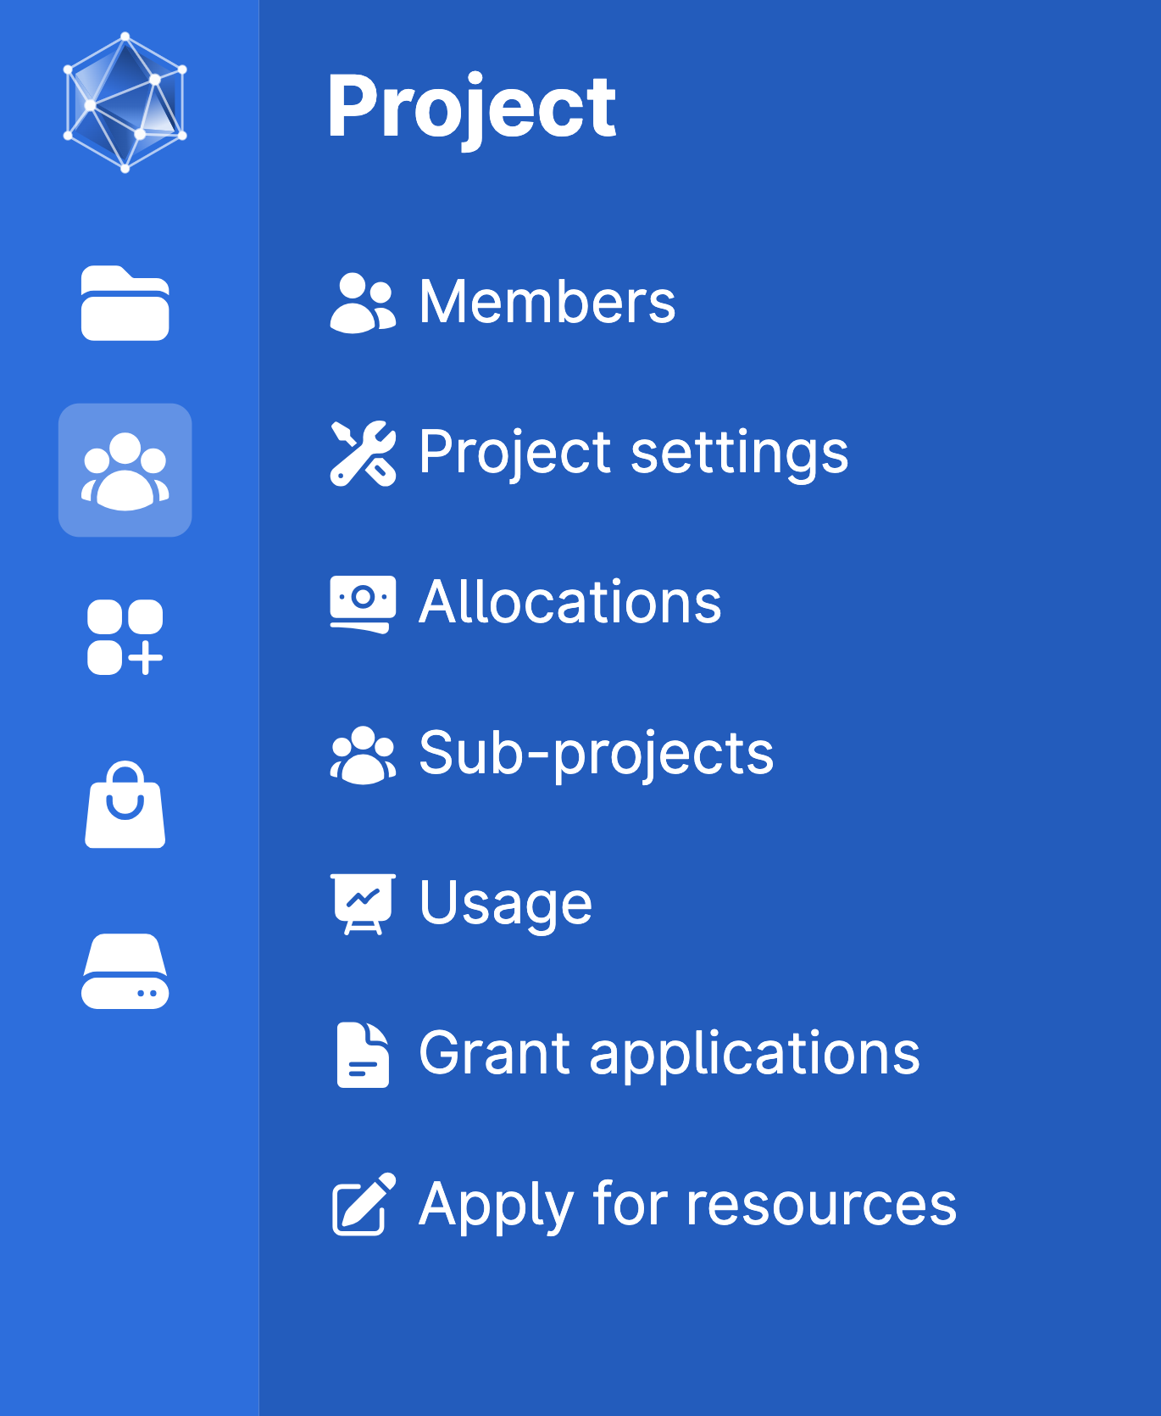
Projects
Projects allow users to control permissions and resources for their workspace and associated files
Notes:
It will look differrent is your workspace vs a shared project

Slide 11
Projects
2
Projects allow users to control permissions and resources for their workspace and associated files
1
Notes:
It will look differrent is your workspace vs a shared project

Slide 12
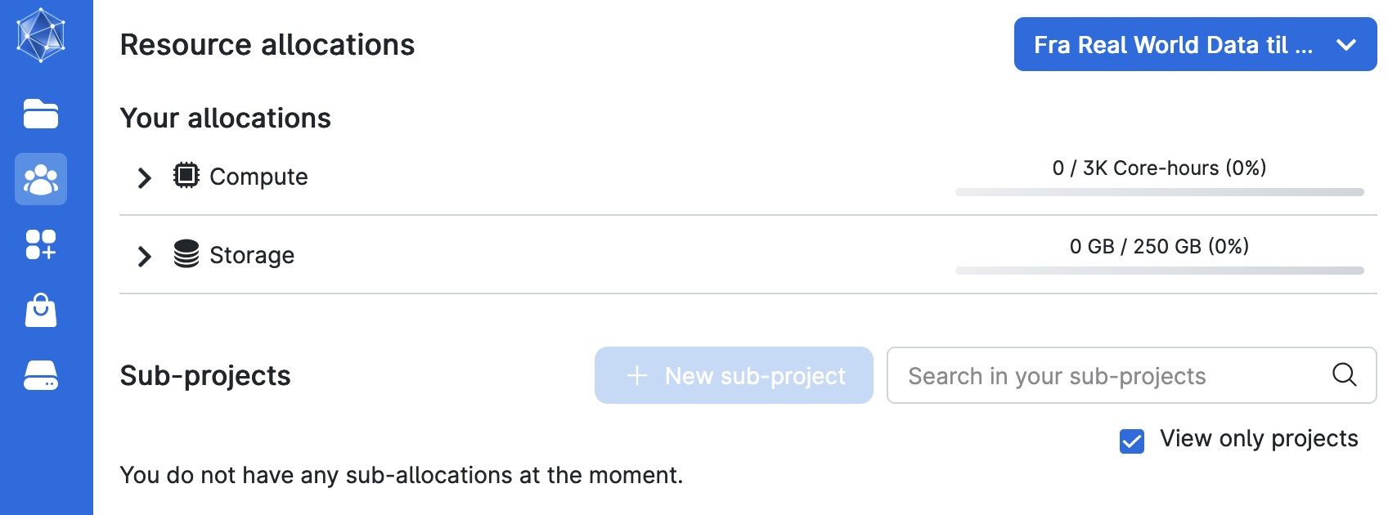
Resource allocation

Slide 13
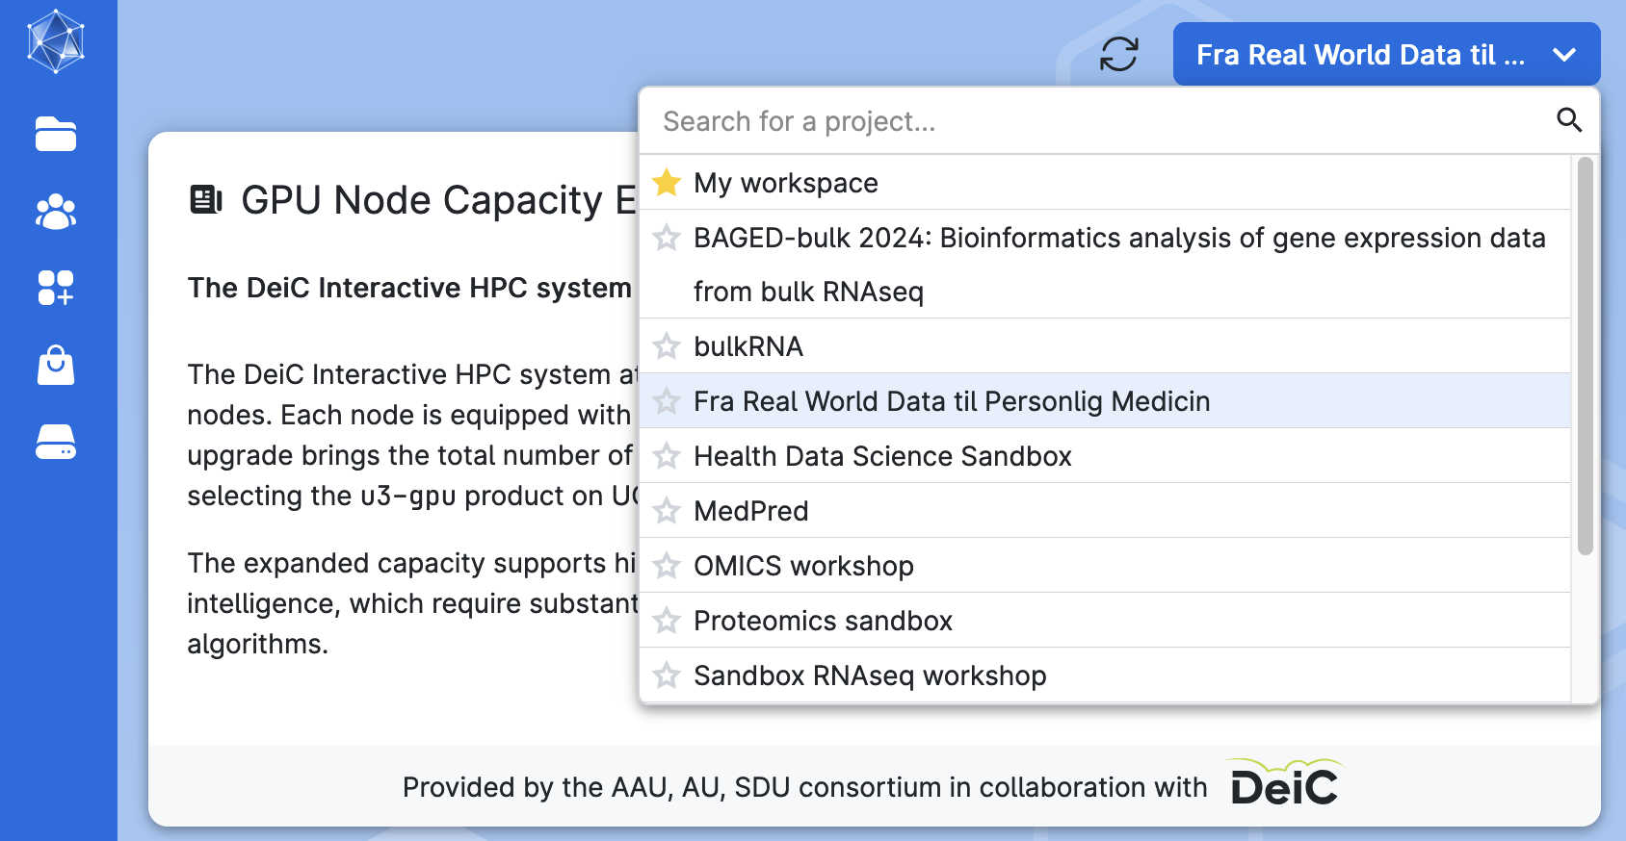
Workspaces
1
2
Virtual workspaces allow you to share resources and work together with project collaborators
Project folders and files that only belong to the active workspace will be accessible from the menu at the left
Notes:
The central dashboard provides a broad summary of the user's activities within the currently active project. Users can refresh the section or switch to a different project using the controls located on the top-right side of the central dashboard:
TO DO: HGIHLIGHT THE PROJECT FOR THIS COURSE

Slide 14
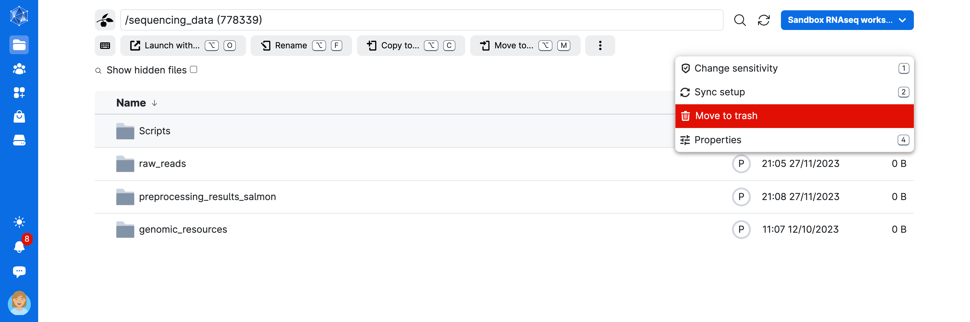
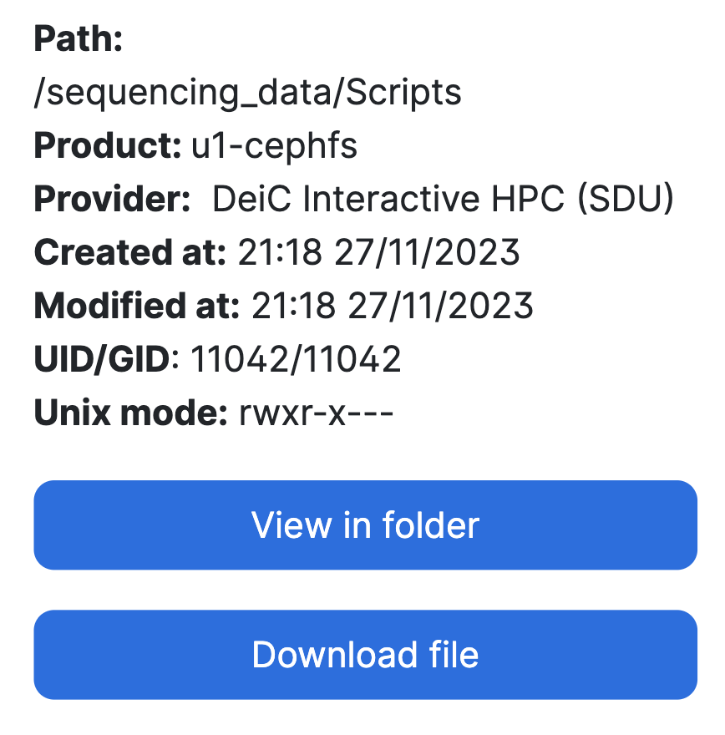
File management
Notes:
If we click on the sequencing data, we can see the content, and the drop down meny, properties

Slide 15
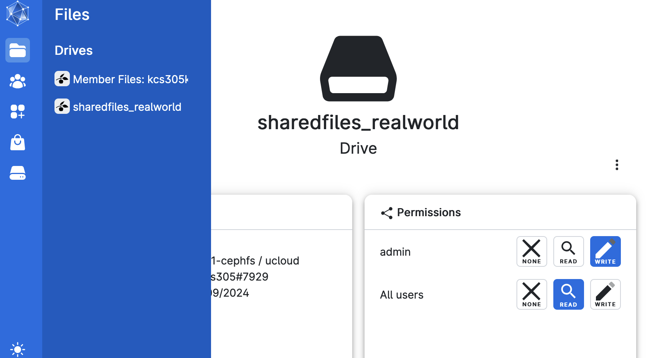
File management
Notes:
If we click on the sequencing data, we can see the content, and the drop down meny, properties

Slide 16
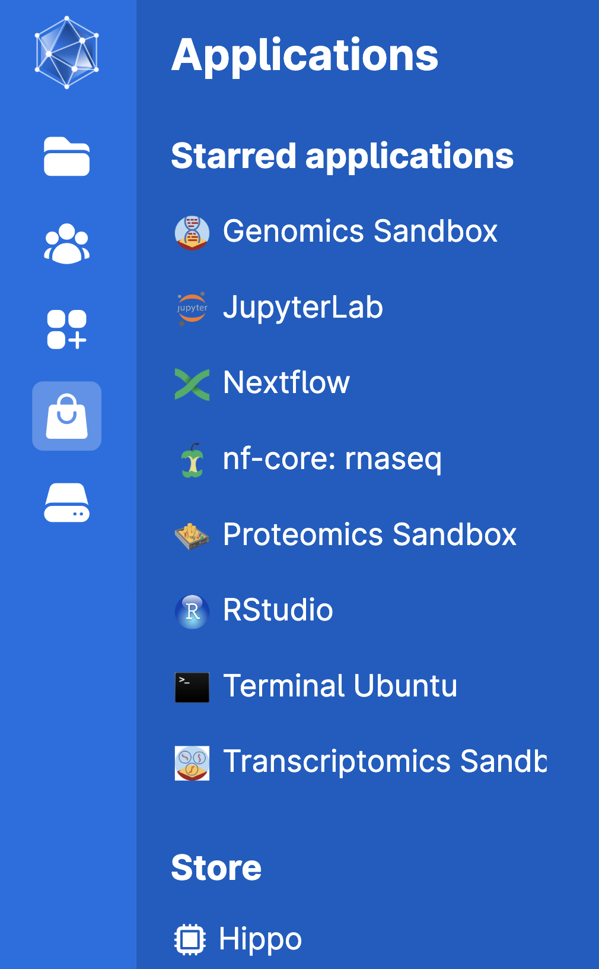
Apps
Yes, there is a point and we can actually use tools and custom environments to do computing on UCloud

Slide 17
Apps
Yes, there is a point and we can actually use tools and custom environments to do computing on UCloud
You’ll need to go to the store and star RStudio in order to add it to your starred applications (for easy access)
1
2

Slide 18
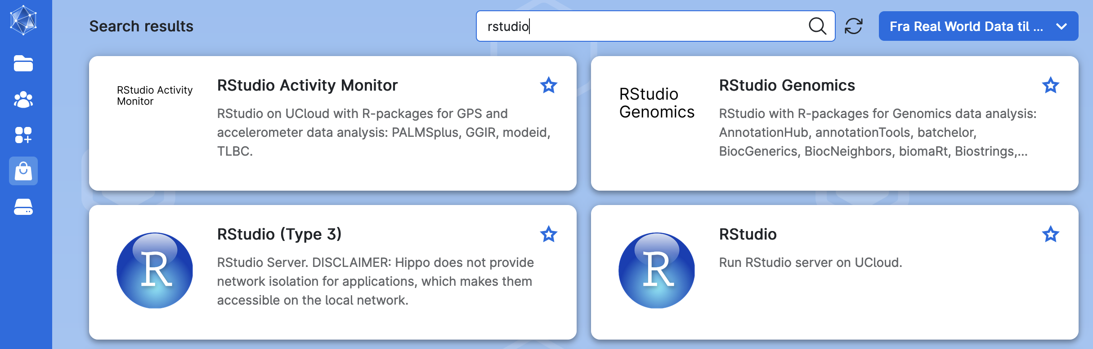
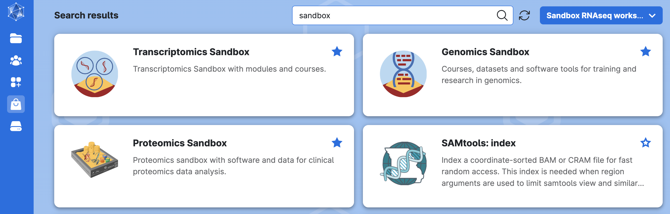
Submitting a job with the RStudio App

Slide 19
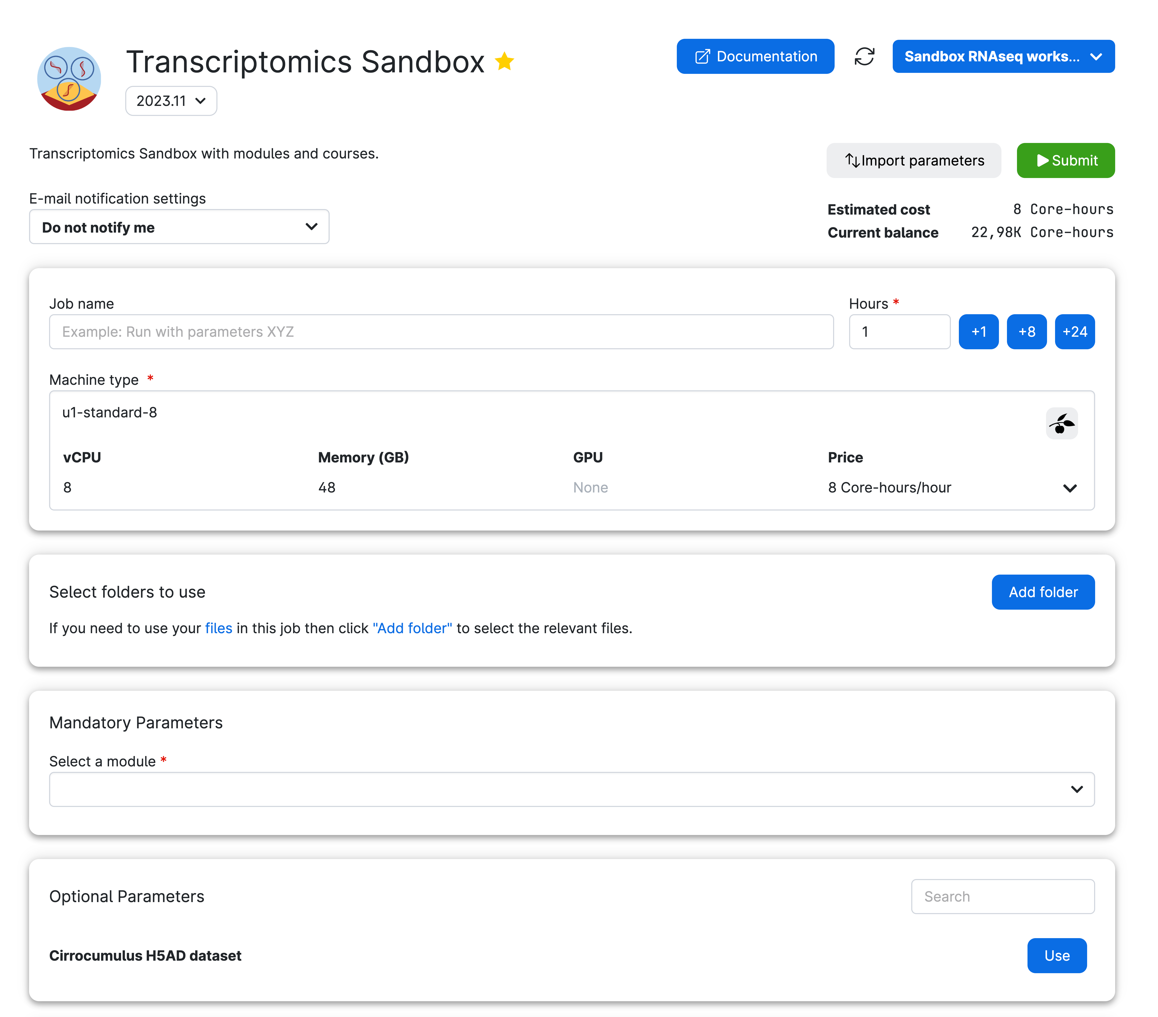

Submitting a job with a UCloud app
1
2
7
3
1
App & version (dropdown menu to change it)
Read documentation before using it
Import parameters from previous runs or JSON file
Job name, hours, and machine type (resources set-up)
Folders to access while running this particular job
Module to use (which includes Notebooks & Data)
4
2
3
5
4
5
6
6
7
Notes:
Break into multiple slides (steps )

Slide 20
Submitting a job with a UCloud app
For those with some HPC experience… this all looks very familiar and maybe overly complicated compared to a bash file you submit to a scheduler
For trainees just getting started, we’ve found the UCloud GUI to be a friendly HPC starting point

Slide 21
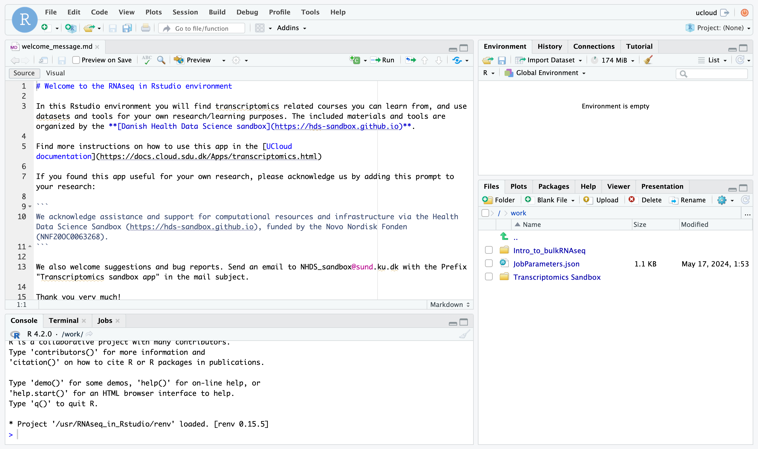
Sandbox RStudio-based app
In the transcriptomics app, you will get RStudio in your web browser. Click on the Transcriptomics Sandbox folder and navigate through the R Markdown notebooks to run the analyses.

Slide 22
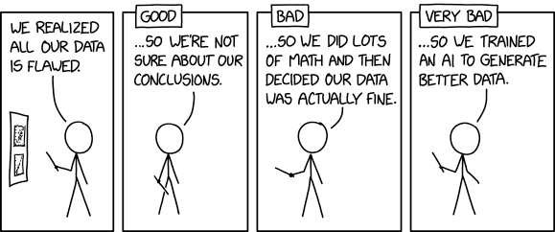

Calibrating expectations for data analysis
https://imgs.xkcd.com/comics/flawed_data.png
Notes:
https://www.explainxkcd.com/wiki/index.php/2341:_Scientist_Tech_Help
https://m.xkcd.com/2582/

Slide 23
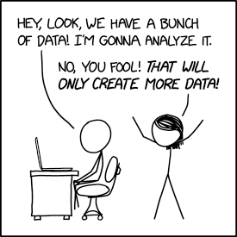
Data analysis: a discussion of terms
You have likely heard the words
Data Science (DS), Machine Learning (ML) and Artificial Intelligence (AI)
These are often used as synonyms, but they do not mean the same thing
What do they mean? Let’s discuss!
https://imgs.xkcd.com/comics/data_trap.png
Notes:
https://www.explainxkcd.com/wiki/index.php/2341:_Scientist_Tech_Help
https://m.xkcd.com/2582/

Slide 24
Data analysis: a discussion of terms
DATA SCIENCE != MACHINE LEARNING
Machine learning - development of algorithms that enable computers to learn from data and make predictions or decisions (with human-like performance or better)
Data Science (DS) - a variety of techniques for extracting knowledge from data - involves cleaning, normalizing, and analyzing large data to uncover patterns and trends
https://imgs.xkcd.com/comics/data_trap.png
Notes:
https://www.explainxkcd.com/wiki/index.php/2341:_Scientist_Tech_Help
https://m.xkcd.com/2582/

Slide 25
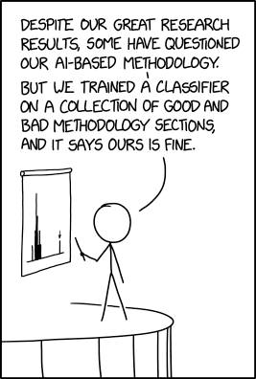
Data analysis: a discussion of terms
Artificial Intelligence:
The ability of computing systems to achieve human-like performance on complex tasks
Conceptual umbrella term
AI is the outcome, not the method
https://imgs.xkcd.com/comics/ai_methodology.png

Slide 26

Data analysis: a discussion of terms
Machine Learning:
"Technologies and algorithms that enable systems to identify patterns, make decisions, and improve themselves through experience and data" [1]
Machine learning is methodology
Currently our most successful way of achieving AI
https://imgs.xkcd.com/comics/machine_learning.png

Slide 27
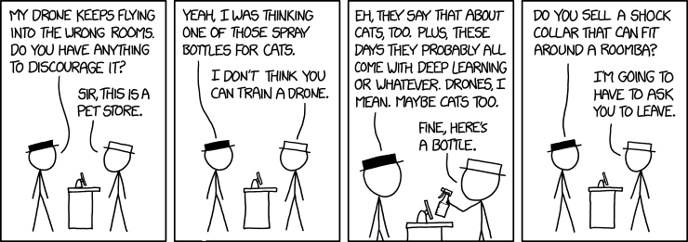
Data analysis: a discussion of terms
https://imgs.xkcd.com/comics/drone_training.png
Deep Learning:
When you do ML by means of a deep neural network
This is a type of/sub-class of ML using a more complex architecture of a specific ML tool (neural network), which is one of the many varieties of ML tools
ChatGPT and other major large language models were created with this technique
Notes:
https://www.ibm.com/think/topics/ai-vs-machine-learning-vs-deep-learning-vs-neural-networks

Slide 28

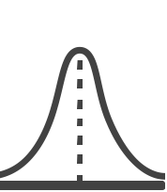
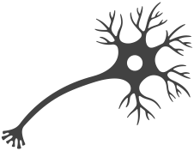
WHAT IS DATA SCIENCE?
The processing and analysis of data with the goal of learning something about its characteristics or answer a scientific question
A cross-disciplinary undertaking that draws on many disciplines and is in turn becoming part of many disciplines.
Data matters, one size analysis does not fit all.
PROGRAMMING
ML/AI
DATA
SCIENCE
MATH & STATISTICS
DOMAIN KNOWLEDGE

Slide 29

WHAT IS HEALTH DATA SCIENCE?
In Health Data Science the domains of interest are medicine (micro)biology, biochemistry, etc.
PROGRAMMING
Field is concerned with:
Biological mechanisms central to disease development
Discovery and assessment of disease specific drug treatment
Disease progression and patient survival
Personalized medicine
ML/AI
DATA
SCIENCE
MATH & STATISTICS
MEDICINE
BIOLOGY

Slide 30

THE DATA-HYPOTHESIS CYCLE
Hypothesis-driven:
'traditional' way of research
formulate hypothesis
design experiment to challenge
hypothesis supported or rejected
Data-driven:
Discover properties of data set
Identify patterns and relationships
Mostly possible with BIG datasets
data-driven ≠ fishing!

Slide 31


THE DATA-HYPOTHESIS CYCLE
High-dimensional data with many observations
Discover complex patterns that humans cannot identify without algorithms & computer power
Find new patterns from re-analysis with new (multiple) methods or combination of datasets
Hypothesis
Gather new data to confirm or deny new hypothesis
Data
We do both alternatingly
Notes:
Patterns are high dimensional, hierarchical, several variables

Slide 32










DATA COLLECTION & TERMINOLOGY
Data points are observations of reality, made with the help of measuring devices or techniques which means:
Measurement uncertainty (technical variation)
Introduced biases
Type and impact of of these may be known or unknown
Datasets:
Observations, the properties collected, i.e. a cell, a patient sample
Variables (Features), i.e. blood pressure, smoker status, gene expression
Outcome variable(s) (dependent)
Explanatory variables (independent)?
Notes:
Bias is a systematic tendency in which the methods used to gather data present an inaccurate or skewed view of reality
Understanding the source of statistical bias

Slide 33
DATA TYPES IN HDS
Measurements
i.e. height, weight, heart rate
Represented as a number or a category
Often low dimensional, but wearables are changing that
Survey Data
Can be descriptive, numeric or categorical
Relies on reporting, i.e. very prone to bias
MEASUREMENT
SURVEY
DATA
Omics Data
i.e. genomics, proteomics
(Ultra) high-dimensional
Needs a lot of preprocessing
OMICS
DATA
Descriptive Data
i.e. patient journals, registry data
Highly person-sensitive
Not easily standardized
DESCRIPTIVE
DATA

Slide 34
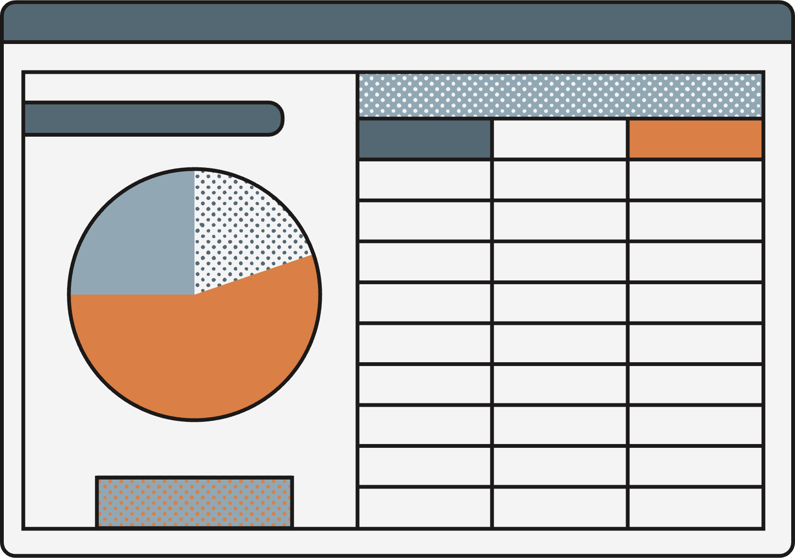



NEW TOOLS FOR DATA ANALYSIS
Absolutely massive amount of data! Both in terms of number of observations as well as number of measured variables
New types of data (i.e. omics, geolocation, wearables, ect)
change of tools
new analysis techniques
Notes:
So we understood that a lot has changed and now we work with tons of data and we need analysis, langauge

Slide 35




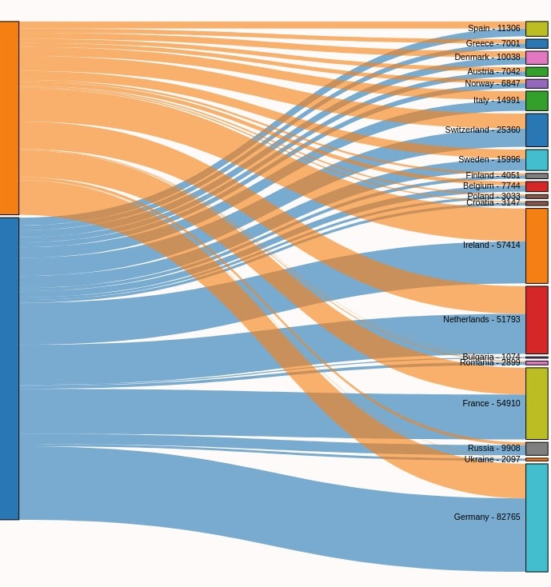
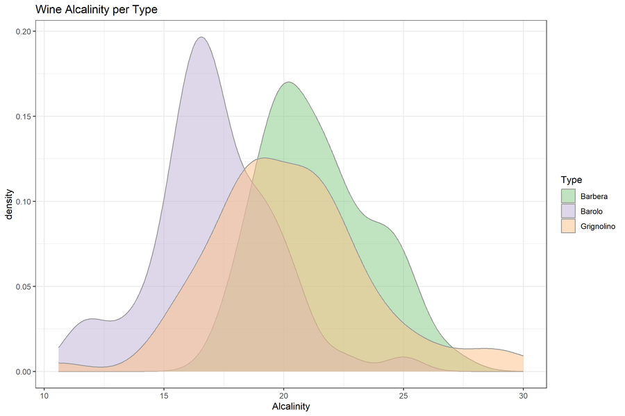
PROGRAMMING LANGUAGES
Part of the new tools is the use of formal programming languages to analyze data instead of tools like Excel.
/
Quick overview
Processing power
Easy starting
Data Wrangling
Reproducibility
Raw data exposed
Complex analyses
Manual analysis
Programming language

Slide 36
FROM EXCEL TO R
GRAPHICS
WHY R ?
Open Source
Easy to get started with:
Compatible with all systems, great support
Large Community:
R-packages, pipelines, tutorials, help pages
Flexible Language:
Plugins, git/github, R Shiny, Rmarkdown, …
Customisable Graphics
R has its limitations, but now fewer than ever
COMMUNITY
OPEN SOURCE
R
EASY START
FLEXIBLE
4

Slide 37

A COMPARISON
FROM EXCEL TO R
Max: 1000000 rows and 16000 cols
Upper limit of an object in R is 2^31
Limited to some operations
Super flexible, almost everything
Some Stats, mostly math
Stats/bioinf., etc. different fields
Okay for the basics
R
Highly customised plots
Cells are mutable - ‘bad’
Markdown, Git, shiny, etc.
Great for small/medium data
Big Dataset
Especially great for big data
Data Wrangling
Data Analysis
Plotting
Reproducibility
Quick Overview
5

Slide 38



FROM EXCEL TO R
WHAT WILL YOU LEARN IN THIS COURSE?
DATA WRANGLING
PLOTTING
tidyverse
Data Structures
Useful Functions
Pipe (“clean” code)
ggplot2
Code structure
ggplot2 + tidy data
THE BASICS
REPRODUCIBILITY
R
R base syntax
RStudio
Scripts, paths, files
R project
Help recourses
R Markdown
Doc. types
Good practices
Other cool things
APPLIED STATISTICS IN R
6

Slide 39
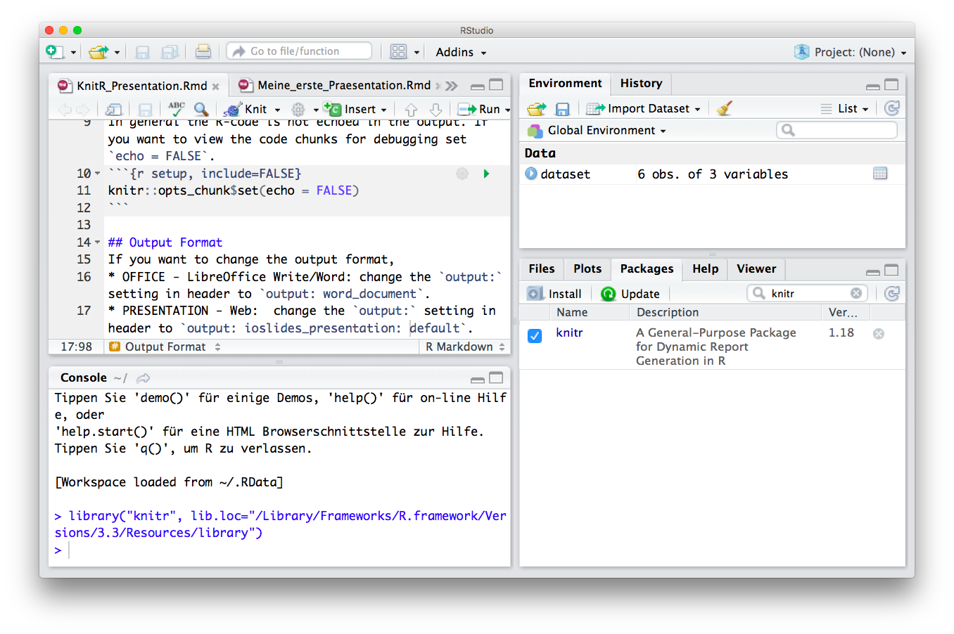

FROM EXCEL TO R
R & FRIENDS
R
R
Studio
Scripting / Programming Language
Objects in Environment
R-scripts (Save Your Code)
Console (Run and Test Code)
Overview by Type, Help and R-packages
Reports (html, pdf, latex)
R Code Interpreter and Editor
8
Notes:
Markdown is a plain text language with formatting syntax designed so that it can be converted to HTML and many other formats.
They are written using an extension of markdown syntax that enables R code to be embedded in them in a way which can later be executed.
Knitr takes a plain text document with embedded code, executes the code and 'knits' the results back into the document.

Slide 40
FROM EXCEL TO R
THE ANATOMY OF R
R
Studio
.R
.Rmd
R
package
Function
Arguments
Editor
Scripts
Code documents
Bundle of functions
and packages
Reproducible code
Arguments as input
Input args. X, Y
Output Z
R
Language
9
Notes:
A double is a double-precision, 64-bit floating-point data type. It accommodates 15 to 16 digits, with a range of approximately 5.0 × 10−345 to 1.7 × 10308

Slide 41
1. R Project
File —> New Project —> New/Existing —> Create Project
FROM EXCEL TO R
R STUDIO BASICS
2. Set Path
getwd() - Get directory
setwd() - Set directory
setwd(“/Users/Tom/Rstuff”) - Full path
setwd(“./Rstuff”) - Relative path
Session —> Set Working Directory —> Choose Directory
R
Studio
3. R Script
Script Icon —> R Script —> File —> Save as …
4. Install and load a R package.
install.packages(“my.package”)
library (my.package) - Load package.
Tools —> Install packages —> my.package
11

Slide 42
FROM EXCEL TO R
ONLINE RESOURCES FOR R
https://www.r-project.org/
GET STARTED
GRAPHICS
BOOKS & COURSES
OTHER RESOURCES
https://rseek.org/
https://rstudio.com/resources/cheatsheets/
http://www.cookbook-r.com/
https://www.statmethods.net/r-tutorial/index.html
https://www.r-bloggers.com/best-books-to-learn-r-programming/
https://www.datacamp.com/
https://www.codecademy.com/
https://www.coursera.org/
https://github.com/trending/r
https://blog.revolutionanalytics.com/
https://stackoverflow.com/questions/tagged/r
https://www.r-graph-gallery.com/
http://r-statistics.co/Top50-Ggplot2-Visualizations-MasterList-R-Code.html
12

Slide 43
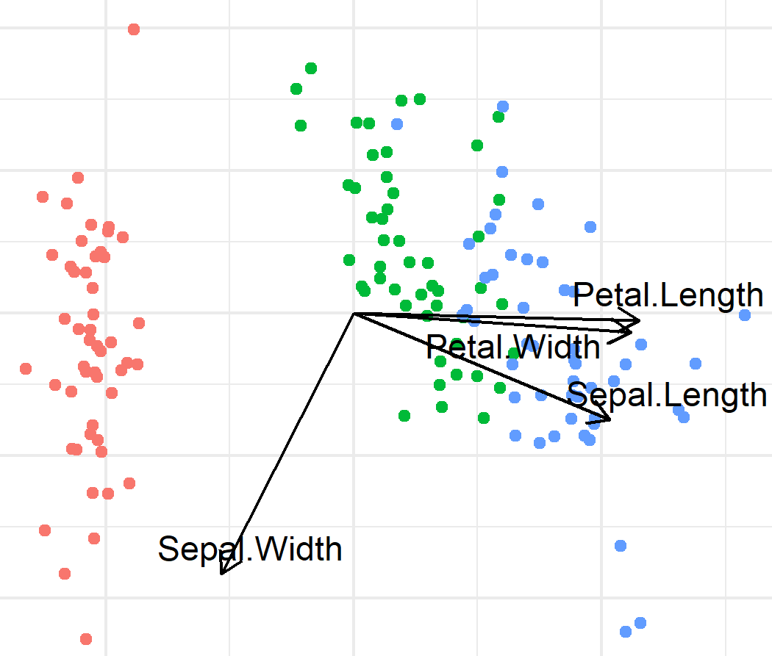
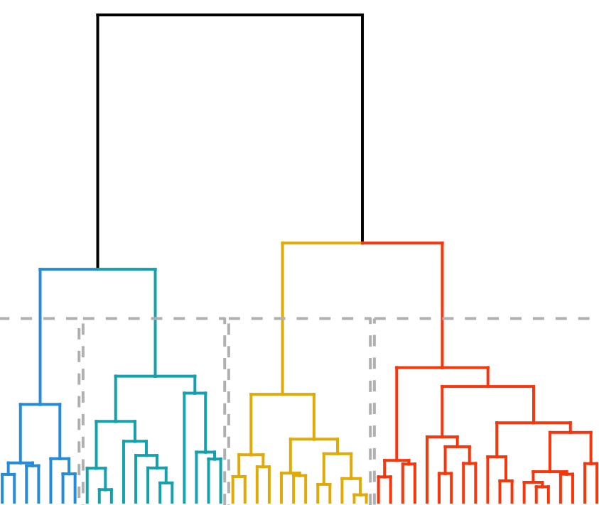
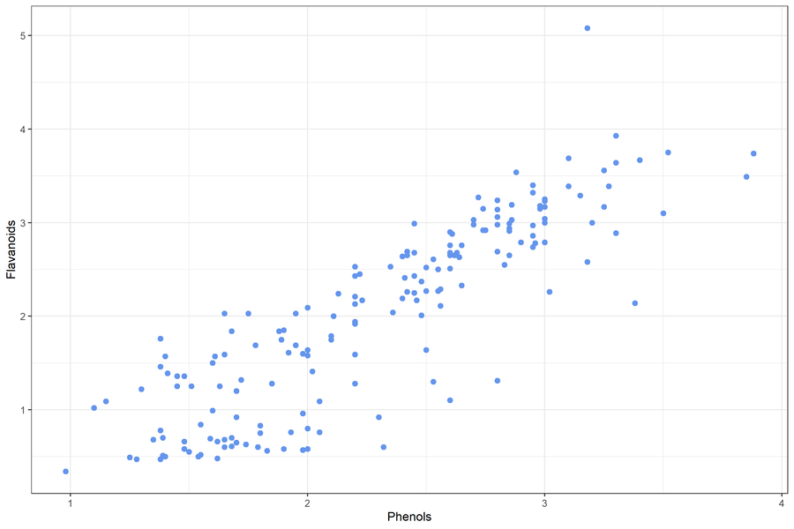
EXPLORATORY
DATA ANALYSIS
Biplot
Density Plot
Before we start our analysis we need to familiarize with the data.
What data do we have?
Does it look as you expected?
Is it suitable for the planned analysis?
How do we need to prepare the data for analysis?
Dendrogram
Scatter Plot
Notes:
Need to check both your own data and data you find somewhere else (repositories,ect)
It’s important to find good data
Examples of ‘bad’ stuff:
Linear regression on 3 data points
T-test on 5 data points
Confirm that data is suitable for planned analysis
Or
Help with idea generation(patterns, relationships between variables)
Establish whether:
Data looks as expected
identify obvious errors: outliers, label swaps
Something needs to be corrected
Preparation method
(normalization is needed?)
Are there patterns between variables?
What is the relationship between variables
How do we need to prepare the data for analysis?
What kind of analysis can we do?
https://www.ibm.com/topics/exploratory-data-analysis
Originally developed by American mathematician John Tukey in the 1970s, EDA techniques continue to be a widely used method in the data discovery process today.

Slide 44
DATA CLEANING AND SET-UP
Wide w. missing values
We want to clean up our data:
Remove data outliers or duplicates
Ensure categorical variables are spelled the same
Change one type of variable to another type
Merge, add or remove variables
Layout, long VS wide format
Treatment | Age | height | weight
A | 55.0 | NA | 65.7
B | 31.0 | 172.0 | 69.4
C | 39.0 | 161.0 | NA
Imputation
Treatment | Age | height | weight
A | 55.0 | 170.0 | 65.7
B | 31.0 | 172.0 | 69.4
C | 39.0 | 161.0 | 58.1
Wide to long
Treatment | variable | value
A | Age | 55.0
A | height | 170.0
A | weight | 65.7
B | Age | 31.0
B | height | 172.0
B | weight | 69.4
C | Age | 39.0
C | height | 161.0
C | weight | 58.1
Missing values:
Filter out some/all missing values
Impute missing values (Regression, Maximum Likelihood, ML)
Notes:
Types of variables: factors, binary, characters, numerical, integers

Slide 45
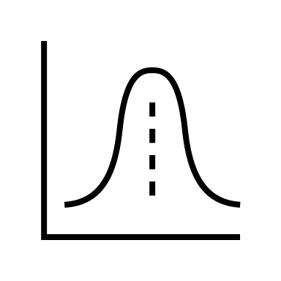
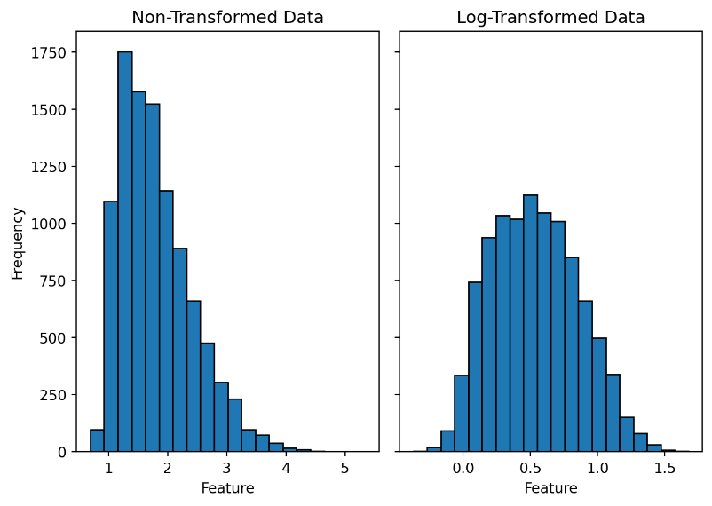
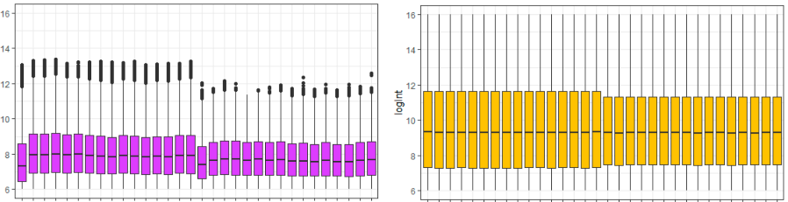
STANDARDIZATION & TRANSFORMATION
NORMALIZATION
STANDARDIZATION
TRANSFORMATION
TRANSFORMATION
x̅
0
sd = 1
Can use for not normally distributed data.
Variables do not get zero centered.
Normalization within a range (max, min).
Affected by outliers.
For normally distributed data
Scaled to a mean of 0 and standard dev. of 1.
Not constrained to a range.
Not affected by outliers.
Attempt to make data normally distributed
Often logarithmic transformations
Squeezes outliers for less impact on model.
Notes:
We do not do standardization in the analysis of high throughput omics data, mainly because these data do not follow a normal distribution.

Slide 46
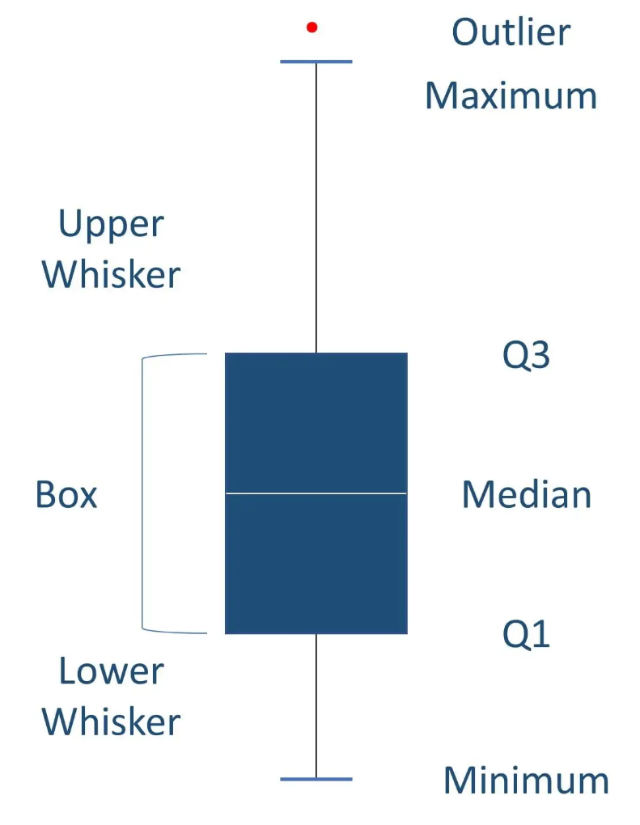
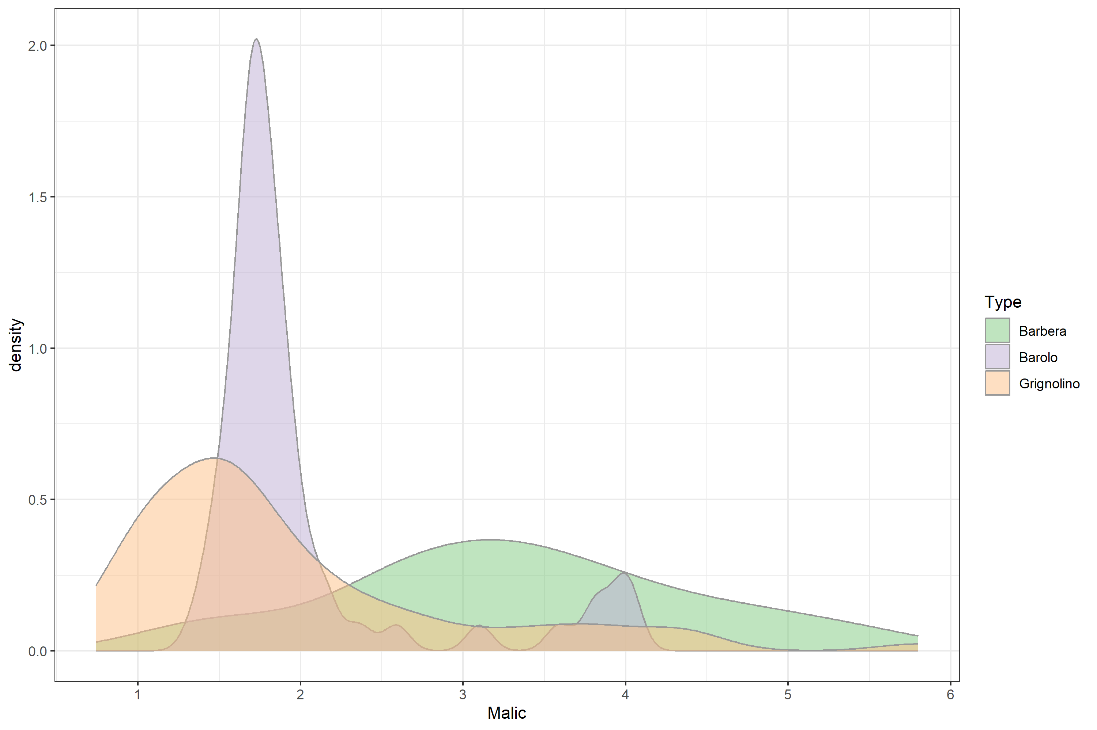
SUMMARY STATISTICS
Summary statistics are used to distill a dataset into some key characteristics.
They often include the following measures:
Central tendency (mean, median, mode)
Spread (standard deviation)
Minimum and Maximum
Quartiles
Shape of the distribution
Correlation between features
Notes:
Scales
Some features more predictive than others
Technical variables to be removed/included
Missing values

Slide 47
DATA STRUCTURES
DATA TYPES
Vector
Numeric
Age
-1.5, 2.7, 3.2
Data Frame
Age
Height
BMI
Integer
FROM EXCEL TO R
-2, -1, 0, 3, 5
R DATA TYPES & STRUCTURES
List
Character
“A”, “Bat”, “Tom”
VARIABLES
Array
Factor
OBSERVATIONS
G1, G1, G2, G3
Tibble
Logical
< >
< >
< >
< >
< >
TRUE, FALSE
13
Notes:
A double is a double-precision, 64-bit floating-point data type. It accommodates 15 to 16 digits, with a range of approximately 5.0 × 10−345 to 1.7 × 10308

Slide 48
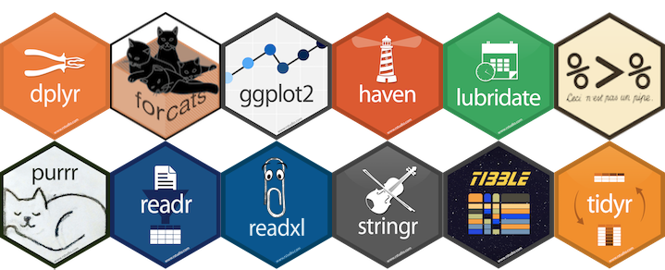
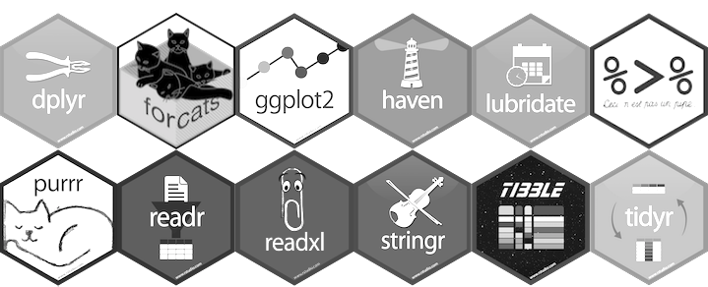

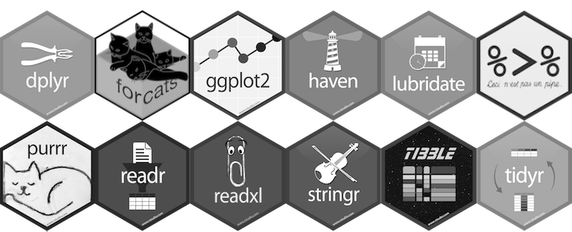
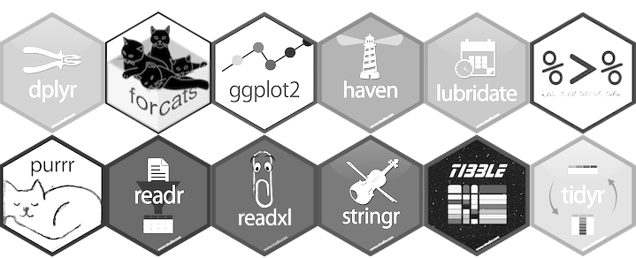
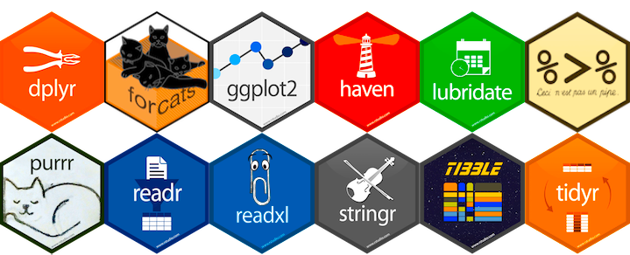
tidyverse is a collection of R packages for data science
READING DATA
“The packages share an underlying design philosophy, grammar, and data structures.” Wickham and Grolemund
TIDYING
https://www.tidyverse.org/
TIDYVERSE
MANIPULATION
tidyverse is used to “tidy up” your datasets, so they are easy to work with
PROGRAMMING
VISUALIZATION
18

Slide 49
https://www.tidyverse.org/
TIDYVERSE CHEAT SHEET
readr, tidyr, dplyr, …
Read Data (readr)
Data Tidying (tidyr)
Data Manipulation (dplyr)
Reading tabular data
There are solutions for multiple data types
read_excel() # using readxl package
read_table()
read_csv()
Useful arguments
Skip lines: read_csv(file, skip=1)
Read subset: read_csv(file, n_max=1)
Data types
readr guesses the types of each column and tells you about it
(“Parsed with column specifications: …”)
Handle missing values
drop_na()
fill()
replace_na()
Subsetting
tibble[:,1:5] # returns a tibble
tibble$colname # returns a vector
(same as tibble[[colname]])
Reorganize layout
Change between long and wide format
gather() # wide to long
spread() # long to wide
Summary
summarise()/summarize()
count()
Group
group_by()
Functions will manipulate each group separately and combine results.
Extract and sort observations # i.e. rows
filter() # subset by condition
distinct() # subset to unique values
top_n() # subset by position
arrange() # sort low->high, other way with desc()
Manipulate variables # i.e. columns
select()
mutate(new_name = f(column))
Vectorised functions
Ranking: percent_rank()
Math: Any arithmetic or logical operations, between(), near()
if_else()
HELP
R Documentation (e.g. enter ?dplyr::filter and see examples)
Much more info and detailed cheat sheets:
https://brianward1428.medium.com/introduction-to-tidyverse-7b3dbf2337d5
It also helps to google “tidyverse + whatever_you_want_to_do”
20

Slide 50
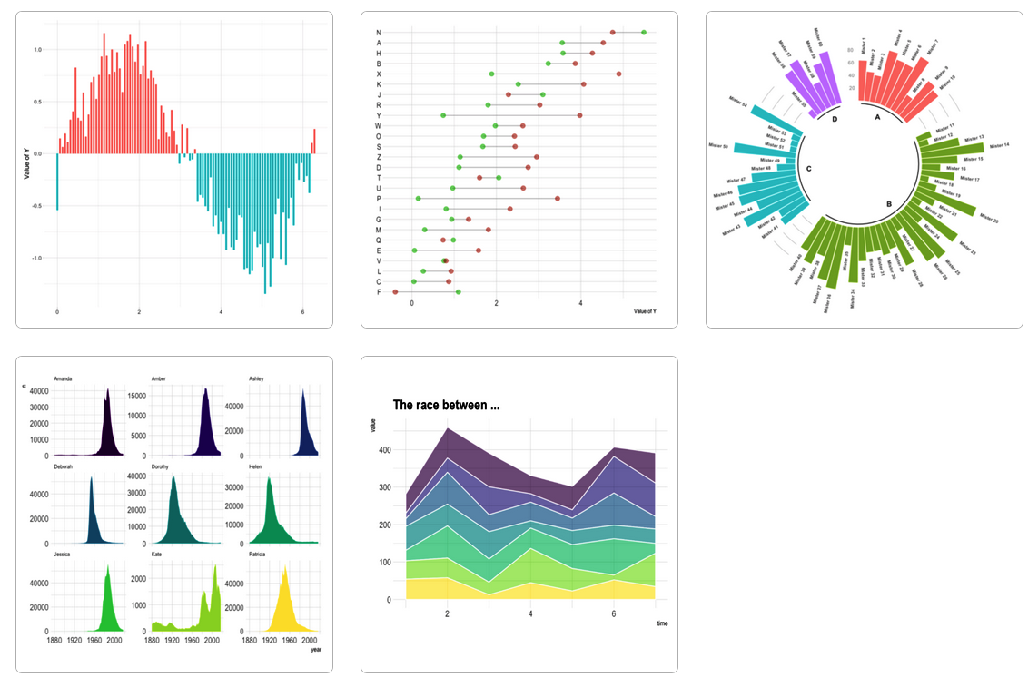
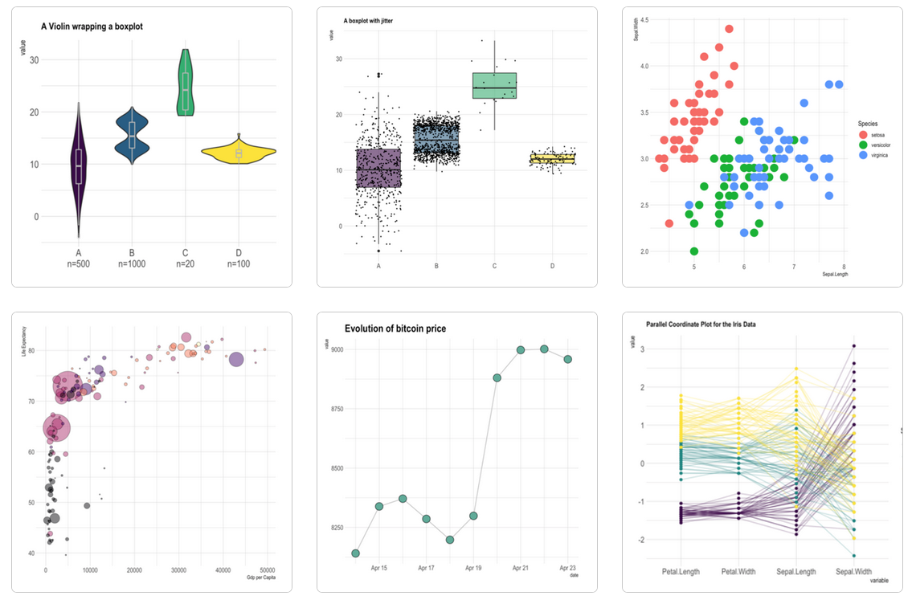
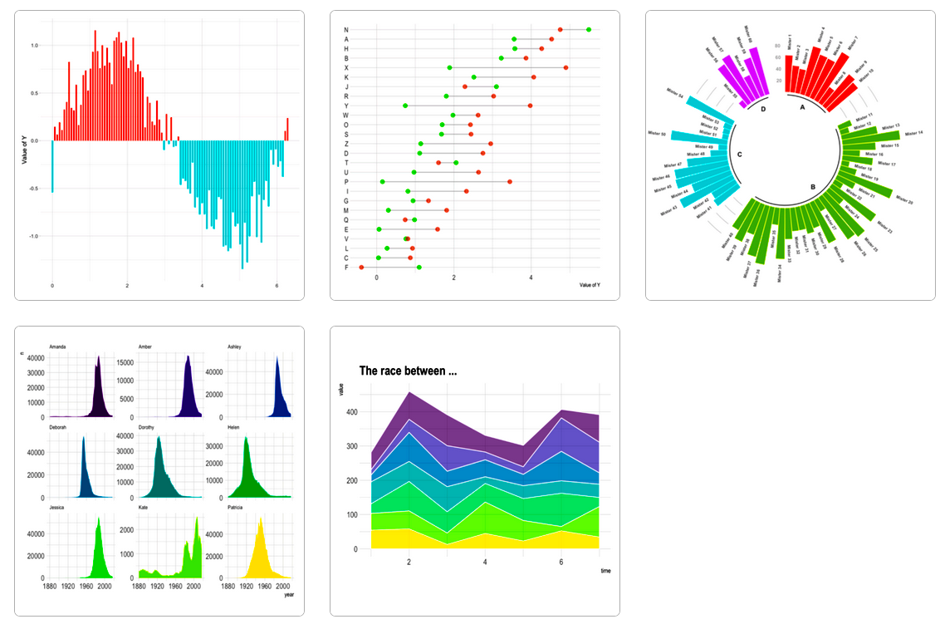
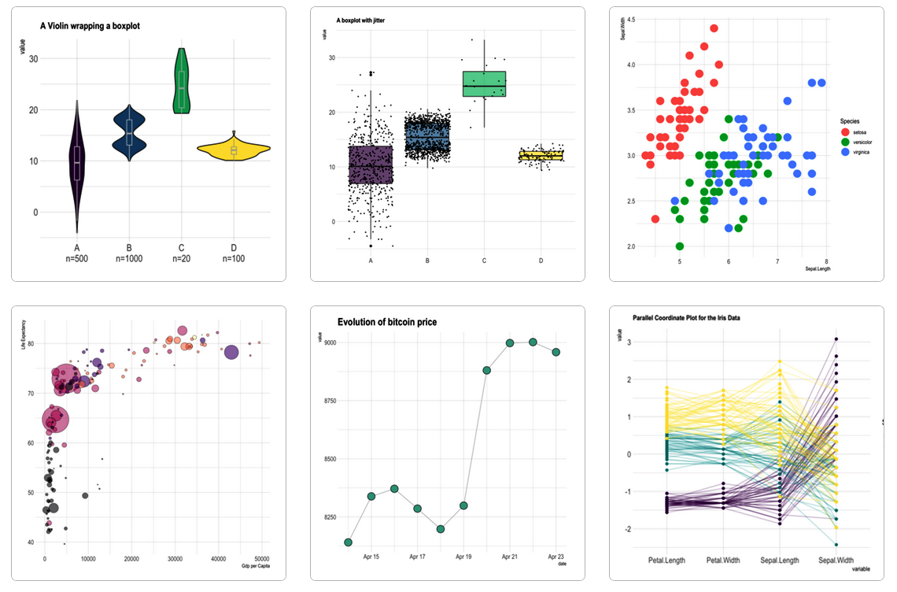

https://www.r-graph-gallery.com/
GGPLOT2 - EASY GRAPHICS
Aesthetically pleasing graphics.
Well-defined “additive” (+) structure.
Integrates perfectly with tidy data.
Great documentation & community
27

Slide 51
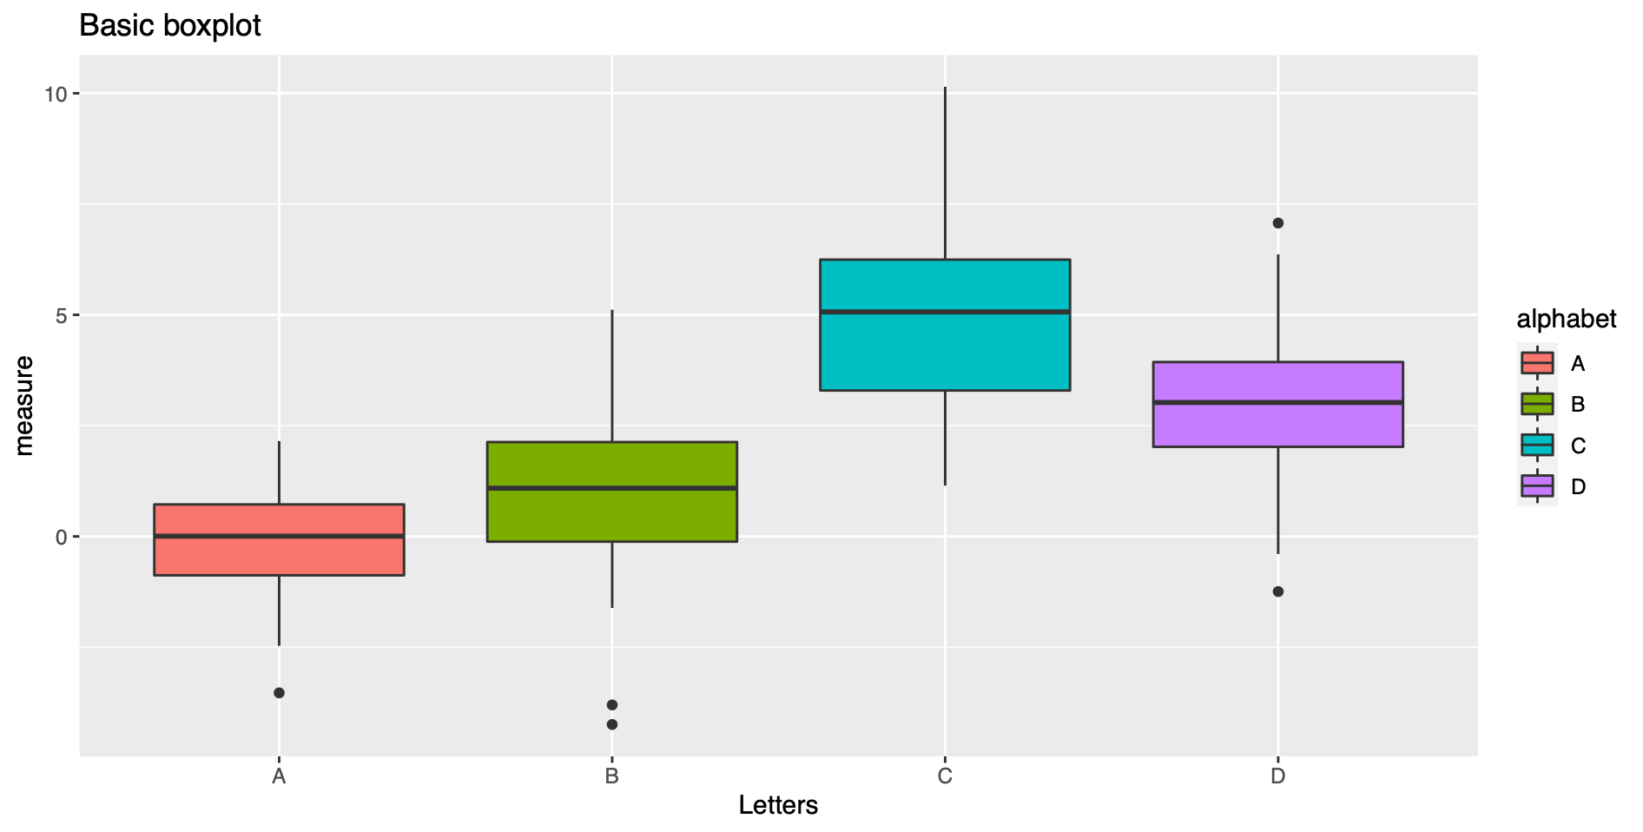
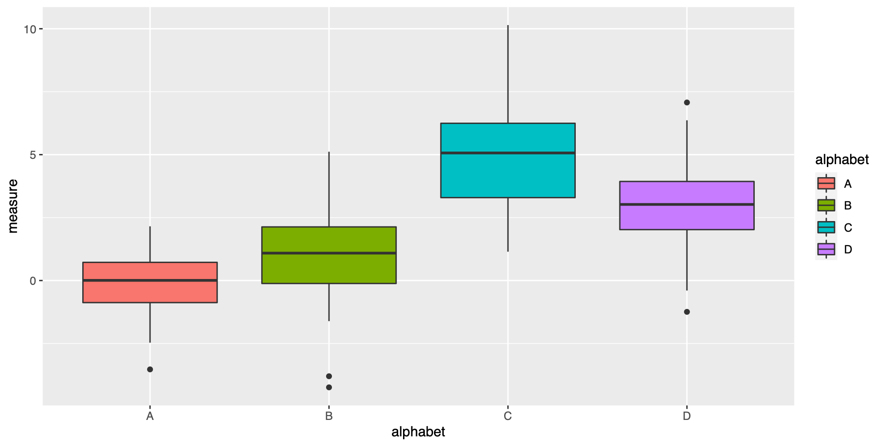
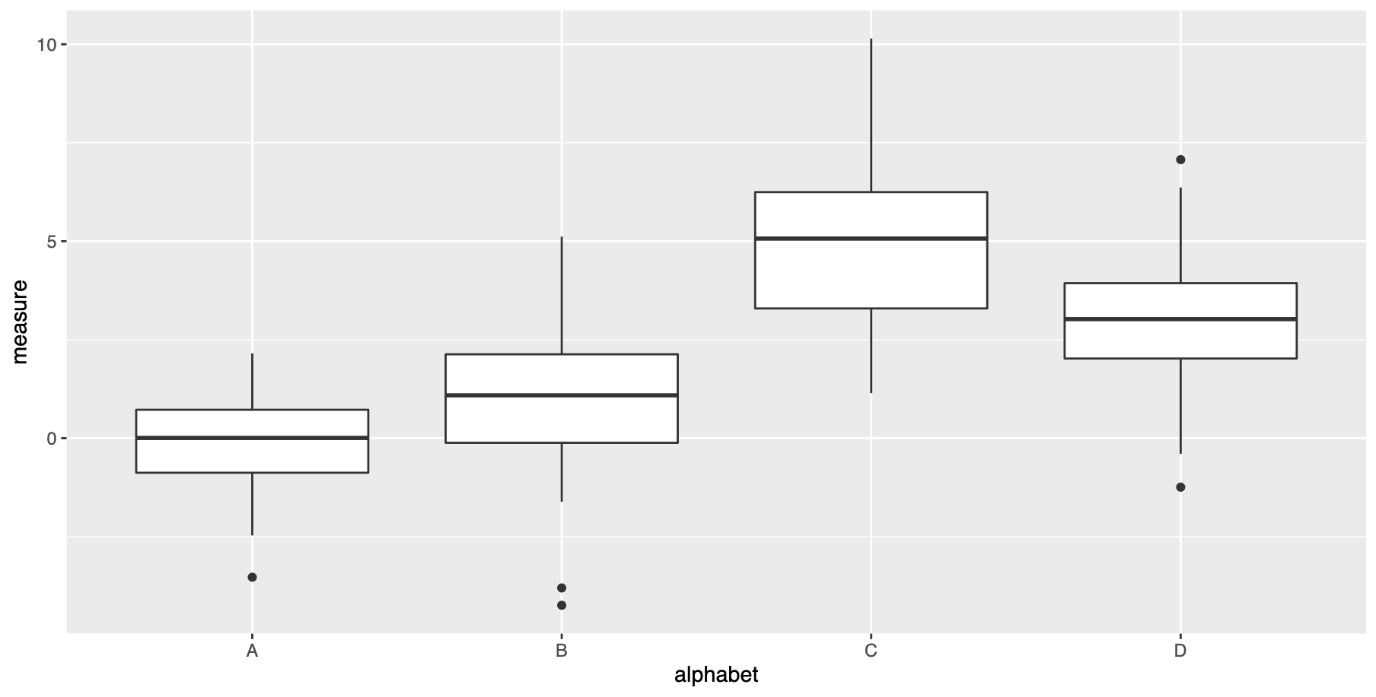
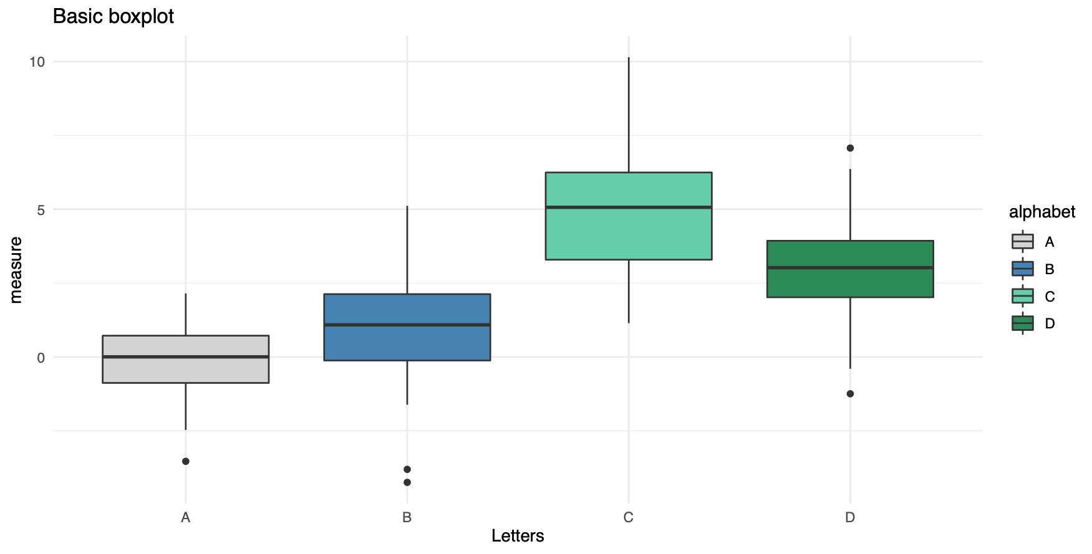
http://tutorials.iq.harvard.edu/R/Rgraphics/Rgraphics.html
DATASET, SAMPLES & OBSERVATIONS
ggplot(my.DS, aes(x=alphabet, y=measure))
GGPLOT2
ADDITIVE STRUCTURE
ggplot(my.DS, aes(x=alphabet, y=measure))
+ geom_boxplot()
DEFINE PLOT TYPE
ggplot(my.DS, aes(x=alphabet, y=measure, fill=alphabet))
+ geom_boxplot()
COLOR BY GROUP
… + ggtitle("Basic boxplot") + theme(legend.position=“none”, plot.title = element_text(size=11))
TITLE AND LEGEND
… + scale_fill_manual(values = c("lightgray", "steelblue",
“aquamarine3", "seagreen4"))
CUSTOM COLORS
BACKGROUND
+ theme_minimal()
28
Notes:
Aesthetic mappings describe how variables in the data are mapped to visual properties (aesthetics) of geoms.

Slide 52
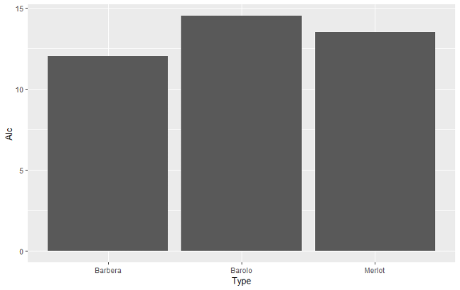
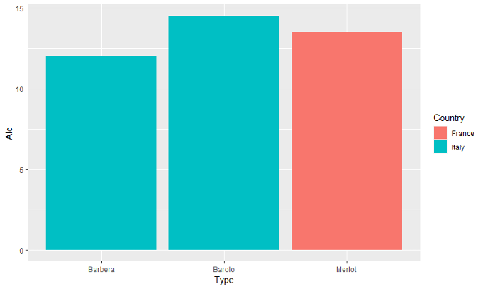
From Excel to R
GGPLOT BASIC STRUCTURE
Type | Alc | Country | Flavonoids | Color
Barolo | 14.5 | Italy | 3.64 | 5.4
Barbera | 12.0 | Italy | 2.41 | 4.5
Merlot | 13.5 | France | 1.57 | 3.8
ggplot(my_wine, aes(x = Type, y = Alc))
ggplot(my_wine, aes(x = Type, y = Alc)) +
geom_col()
ggplot(my_wine, aes(x = Type, y = Alc), fill= Country) +
geom_col()
ggplot(my_wine, aes(…))
{
x - what is on the x-axis
y - what is on the y-axis
color - variable to base the color on
fill - variable to base the fill on
size - variable to base the size on
shape - variable to base the shape on
29

Slide 53
http://tutorials.iq.harvard.edu/R/Rgraphics/Rgraphics.html
DATASET, SAMPLES & OBSERVATIONS
ggplot(my.DS, aes(x=Sample, y=Measure))
GGPLOT2
ADDITIVE STRUCTURE
ggplot(my.DS, aes(x=Sample, y=Measure))
+ geom_boxplot()
DEFINE PLOT TYPE
ggplot(my.DS, aes(x=Sample, y=Measure, fill=Sample))
+ geom_boxplot()
COLOR BY GROUP
… + ggtitle("Basic boxplot") + theme(legend.position=“none”, plot.title = element_text(size=11))
TITLE AND LEGEND
… + scale_fill_manual(values = c("lightgray", "steelblue",
“aquamarine3", "seagreen4"))
CUSTOM COLORS
BACKGROUND
+ theme_minimal()
28
Notes:
Aesthetic mappings describe how variables in the data are mapped to visual properties (aesthetics) of geoms.

Slide 54



From Excel to R
GGPLOT BASIC STRUCTURE
Geoms inherit the parameters from the ggplot they are added to:
Alternatively, you can specify additional parameters directly in the geom:
Things outside the aes are applied to everything!
ggplot(my_wine,
aes(x=Type, y=Alc, fill=Country))
geom_col()
ggplot(my_wine,
aes(x=Type, y=Alc))
geom_col(aes(fill=Country))
ggplot(my_wine,
aes(x=Type, y=Alc))
geom_col(fill='green')
29

Slide 55
https://rstudio.com/wp-content/uploads/2016/11/ggplot2-cheatsheet-2.1.pdf
GGPLOT CHEAT SHEET
Define Plot:
Add Plot Type:
+ geom_point()
+ geom_line()
+ geom_boxplot()
+ geom_col()
+ geom_density()
+ geom_histogram()
GET STARTED
ggplot(data = my.data, aes(x = x.var, y = y.var))
One Color:
Color Fill by Group:
Custom Colors:
ggplot(…, aes(…, color = “green”))
ggplot(…, aes(…, fill = group.var))
scale_*_manual(values = c())
ex: scale_color_manual(values = c(“blue”, “pink”))
COLORS
More Colors:
Grid Theme:
theme_bw()
theme_minimal()
theme_dark()
theme_*()
COLOR SCALES & THEMES
scale_fill_grey(start = 0.2, end = 0.8)
scale_fill_gradient(low="white", high=“red”)
Labels:
Text:
ggtitle(“…”)
xlab(“…”)
ylab(“…”)
theme(* = element_text())
theme(axis.title = element_text(angle = 90, colour= “red”), legend.text = element_text(size = 8, face = “bold”))
TEXT
29

Slide 56



DATA SCIENCE ANALYSIS
HYPOTHESIS TESTING
PREDICTION/ CLASSIFICATION
UNSUPERVISED LEARNING
RQ: Does this patient have a cataract?
RQ: What sets the cancer cells apart from the healthy cells?
Are there subtypes within one cell type?
RQ: Is there a significant difference in the variable of interest between two or more groups?
RQ: Can we estimate cancer risk based on genetic risk, smoking and age?
Notes:
Many research questions fit roughly into one of these boxes
Research questions can also combine these areas.

Slide 57

HYPOTHESIS TESTING
Questions that boil down to:
Is there a difference in feature A between these two or more groups?
Is the bacterial load higher in colon swaps of cancer patients?
Is the expression of gene A higher in tumor samples?
Is there a difference in median height between men and women?
A difference test:
t-test
ANOVA
Fisher’s exact test
Notes:
t-test (difference between two means)
ANOVA (difference between two or more means)
Fisher’s exact test (association between categorical variables)*

Slide 58

PREDICTIVE MODEL / CLASSIFICATION
Using statistical/ML models to predict outcomes / classify new data.
Discovering and quantifying the relationships between predictor variables and outcome.
Prediction (Regression) == outcome is continuous (weight of newborn)
Classification == outcome is a class/group (cystic fibrosis or healthy)
Logistic Regression
Naïve Bayes
Support Vector Machine
Random Forest
K-Nearest Neighbors
https://towardsdatascience.com/top-machine-learning-algorithms-for-classification-2197870ff501

Slide 59



http://www.sthda.com/english/
R - A STATISTICAL
SCRIPTING LANGUAGE
Y
MODEL FUNCTIONS
lm(), glm()
lmer(), glmer(),
nls(), …
EMMEANS PACKAGE
emmeans(), pairs(), cld()
X
Variable 1
Variable 2
A
B
APPLY TO MODEL
MORE FUNCTIONS
summary(), anova(), confint(), predict(), drop1(), update(), step(), …
t.test(), cor(), cor.test(), aov(), quantile(), p.adjust(),
rank(), …
C
D
31

Slide 60
https://rstudio.com/resources/cheatsheets/ for various relevant cheat sheets.
Other example: https://www.dummies.com/programming/r/statistical-analysis-with-r-for-dummies-cheat-sheet/
STATS CHEAT SHEET
Import Data:
Overview of Data:
GET STARTED
read_excel(“my.data.xlsx”)
summary(my.data)
nrow(my.data)
length(my.data)
names(my.data)
Linear:
Logistic:
Linear Mixed:
Check Model:
summary(model) par(mfrow=c(2,2))
plot(model)
REGRESSION MODELS
lm(y~x, data=my.data)
confint(model)
glm(y~x,
data=my.data)
lmer(y~x + (1|z), data=my.data)
ANOVA:
F-Test:
Emmeans:
TESTS/COMPARISONS
anova(model2, model1)
drop1(model, test="F")
emmeans(model,~x)
pairs(emmeans(model,~x))
Check Type:
Change Type:
table(my.data$x)
is.numeric(my.data$x)
is.factor(my.data$x)
my.data <- mutate(my.data, x = factor(x))
my.data$z <- as.numeric(my.data$z)
VARIABLES
34

Slide 61

THANK YOU FOR LISTENING
This keynote presentation was created by Thilde Terkelsen, Data Scientist, Center for Health Data Science, SUND, KU.
For internal use at KU only, do not distribute commercially.

Slide 62

UNSUPERVISED LEARNING
Unsupervised Classification: Group observations into clusters.
What if we do not know the groups our data partition into, no labels…
A scientific question could be: Do our observations stratify into groups and what data characteristics drive this partitioning?
For this we use unsupervised learning methods (PCA is one example).
Notes:
Unsupervised classification is basically clustering and then assigning new observations to a cluster. You get a label (cluster 1,2,3) but you don’t know what the label means.

Slide 63


CLUSTERING
Hierarchical Clustering:
Complete linkage
Ward’s method
Clustering == type of unsupervised learning.
Metric to define similarity of observations.
Items of a group share features that we care about.
RQ:
Optimal number of clusters for this dataset?
What characterizes a certain cluster?
Which cluster does a new data point belong to?
K-Means Clustering:
Euclidean distance
Manhatten distance

Slide 64
SUPERVISED LEARNING
Supervised learning is one category of machine learning models.
Supervised means the ground truth is known.
We have labels for the outcome when training our model, i.e. cancer or health sample
Notes:
Unsupervised classification is basically clustering and then assigning new observations to a cluster. You get a label (cluster 1,2,3) but you don’t know what the label means.

Slide 65

CLASSIFICATION OF FRUIT - EXAMPLE
A model trained and evaluated using class labels is used to classify a new data point (label unknown).
Probability (0.68 Grapefruit & 0.32 Lemon)
Response (Grapefruit)
Some models have feature importance ranking.
What feature/variable is most important for classification, i.e. size, shape or color?
Decision Tree – Fruit Classification

Slide 66

NEURAL NETWORKS
Neural Networks (NN) mimics the function and structure of the human brain
NN can be either supervised or unsupervised
We use NN for medical image analysis, genomics analysis, protein structure prediction, etc.
NN can be difficult to understand in detail but not in broad strokes, let's try…

Slide 67
NEURAL NETWORK FOR CLASSIFICATION
Input layer: Data goes in (i.e. patient biometrics, expression data, medical images)
Hidden layer: The model learns data patterns.
This is where the computation is performed.
Many hidden layers == deep neural network
Output layer: Samples are classified as either cancer or healthy.
Forward Propagation == network predicts
Gly. Level
Age
Healthy
BMI
Diabetes
Back Propagation == Networks learns using errors

Slide 68
WHICH APROACH SHOULD WE USE?
STATISTICAL ANALYSIS
MACHINE LEARNING
’Simple’ question
Linear relationships
Small dataset (few obs.)
High dimensional data
Non-linear relationships
SUPERVISED
UNSUPERVISED
The scientific questions asked are central to the methods chosen.
The dataset size guides choice of algorithm.
Outcome is known
Outcome is unknown
Fully data driven
Notes:
Technical variation that affect different samples differently
This can obscure difference or create differences that are not real
We want to remove this variation as much as possible since we are interested in biological variation
There is of course background noise in our data, this can sometimes modelled and sometimes it is so little and random we do not expect it to affect our analysis, in that case we simply ignore it.

Slide 69

MODEL EVALUATION
How do we measure the performance of a model?
How much/far can we trust the results we have obtained?
How do we interpret the results of the evaluation?
GOOD
BAD
Pick evaluation metric based on research question, data and model.
Notes:
Every type of model has their own criteria by which we evaluate

Slide 70

MODEL PERFORMANCE
How well does the model fit the data?
Criteria depend on model type
Good models capture the underlying trends and characteristics
PERFORMACE METRICS:
R-squared
MSE
RMSE
RMSLE
REGRESSION
Accuracy
Precision
Recall
ROC/AUC
CLASSIFICATION
Silhouette
Adj. Rand Indx.
Gap statistic
Davies-Bouldin
CLUSTERING
Notes:
RMSE == Root Mean Squared Error
Relevant for models that have parameters you can choose: regression, classification (not t-test).
The two questions are not the same.
How well does the model fit?
For regression that could be least squares (distance of data points to fitted line)
Good model captures underlying trends and characteristics of the data
Can estimate deviations by goodness-of-fit
For clustering we can evaluate whether the number of clusters we have chosen is optimal
If we did kmeans we may discover the ideal number of clusters using the elbow method:
Different measures to describe “how much are the points in a certain cluster more similar between themself than with the points in different clusters?”
The measures, also called clustering evaluation techniques, are: silhouette score, calinski harabasz score, davies bouldin score. There may be others
We use this to score the goodness/usefulness of the clustering and pick the number of clusters with the highest measure
However, we do not want a perfect fit! Because data always has noise, if the model fits the data too well it will become very poor at doing the actual task (classification) and we get overfitting.
Therefore, we evaluate separately how well the model performs on the task.

Slide 71

CLASSIFIER
PERFORMANCE
Performance measures of classifiers depend on the chosen cutoff.
One can easily optimize on the number of false positives or false negatives, but not both at the same time.
Precision :
Recall/
True positive rate
Notes:
Precision == the ratio of true positive predictions to the total number of positive predictions made by the model.
Specificity == the ratio of true negative predictions to the total number of actual negative cases in the data.
Recall (sensitivity)== the ratio of true positive predictions to the total number of actual positive cases in the data.
Accuracy == the ratio of correctly predicted cases (both true positives and true negatives) to the total number of cases.
There is often a trade-off between precision and recall. Increasing one metric may lead to a decrease in the other. It depends on the specific threshold set for the model to classify predictions as positive or negative.
In the Context of Disease Diagnosis:
High precision is important when the consequences of a false positive prediction are significant, as it minimizes the chances of unnecessary treatments or interventions.
High recall is crucial when the consequences of a false negative prediction are severe, as it minimizes the chances of missing actual cases of the disease.
F1 Score: To balance precision and recall, the F1 score, which is the harmonic mean of precision and recall, is often used. F1=2×Precision×RecallPrecision + RecallF1=Precision + Recall2×Precision×Recall​

Slide 72

AREA UNDER THE CURVE (AUC)
This is why we use the AUC to report on the goodness of the classification.
Receiver Operator Curve (ROC)
Plotted by using every possible cutoff.
Each True Positive Rate has an associated False Positive rate.
How many of the true cases have we discovered?
Notes:
True positive = sensitivity
False positive – 1-specificity(true negative)
In terms of classifiers we always have the trade-off between true-positive and false-positive rates:
If we want few false positives (people predicted to have cancer though they are healthy), we will also have more false negatives (cancer people predicted to be healthy)
If we want to miss as few cases as possible, we will have a high amount of false-positives.

Slide 73

OVERFITTING
Data
Under fit
Appropriate fit
Over fit
Train
Eval
Too simple to explain variance in the data
Parameters capture tendency in data
Too many parameters capture noise in data
Eval
When a model follows the data too closely we get an effect known as overfitting.
We avoid this by splitting the data into training and evaluation sets and controlling the number of free parameters.
Cross Validation
Eval
Eval
Notes:
Relevant for models that have parameters you can choose: regression, classification (not t-test).
The two questions are not the same.
How well does the model fit?
Every type of model has their own criteria by which we evaluate
For regression that could be least squares (distance of data points to fitted line)
For clustering we can evaluate whether the number of clusters we have chosen is optimal
However, we do not want a perfect fit! Because data always has noise, if the model fits the data too well it will become very poor at doing the actual task (classification) and we get overfitting.
Therefore, we evaluate separately how well the model performs on the task.

Slide 74
WHAT DO THE RESULTS MEAN?
Hypothesis testing
Classification / Prediction
A significant p-value
supports the rejection of the null hypothesis.
Poor model performance, the model does not capture the data pattern.
Interpretable parameters?
Coefficients/Feature importance tell which predictor variables have a large influence in outcome
Regression model:
birth weight ~
mother’s weight + smoking +
mother’s age
Avg life exp.
Cigarettes smoked
Notes:
hypo test + pred -> can interpret results directly.
In hypothesis testing the meaning is mainly answering our question.
Is birthweight sig. different between mothers who smoke and non-smokers, yes or no?
Parameters have a meaning, i.e. slope and intercept in a regression model.
If our model is average live expectancy (y) VS cigarettes smoked (x) then the intercept is the life expectancy at 0 cigarettes and the slope is how much life expectancy decreases for one unit of cigarette smoking.
Though the intercept sometimes doesn’t have real life meaning (if x cannot meaningfully be 0, the y-intercept has no useful interpretation).
Example: birth weight ~ mother’s weight + smoking + mother’s age
Coefficients tell us which of these have the largest influence and we can test whether we should drop (not consider) one or several
In a random forest the feature importance takes the roll of the coeff
If model performance is bad that means we cannot answer our question/build a good predictor with the data we have which is also an insight

Slide 75


WHAT DO THE RESULTS MEAN?
Unsupervised Learning/Clustering
Black Box models
Insights about the structure of the data, esp. number of clusters
Further analyse properties of discovered clusters (biological meaning)
Highly non-linear models with many parameters are difficult to interpret
We mostly use the performance instead of trying to gain insights
Predict cluster membership of new data points
Notes:
Clustering:
- Cannot evaluate performance without ground truth
If it’s black box models: many parameters and non-linearity, for example neural network, tSNE, its more difficult
Cannot directly interpret results
Very difficult to know why the model gives a certain answer (why is this skin spot cancerous?) and therefore we do not understand what the model has learned
Performance is good, insights are few
What do results from clustering mean?
We don’t have ground truth so we can’t eval performance as in supervised learning.
I guess we have learned something about the structure of the data
If we did kmeans we may discover the ideal number of clusters using the elbow method:
Different measures to describe “how much are the points in a certain cluster more similar between themself than with the points in different clusters?”
The measures, also called clustering evaluation techniques, are: silhouette score, calinski harabasz score, davies bouldin score. There may be others
We use this to score the goodness/usefulness of the clustering and pick the number of clusters with the highest measure

Slide 76

CORRELATION ≠ CAUSATION
One goal of modelling is to discover relationships between predictor and outcome variable.
However, modelling is not primarily concerned with causality.
If our model shows that a relationship exists, that does not mean the relationship is causal.
Notes:
Predictive power of A over/towards B does not mean that A causes B.
Add example
Example:
We know now that smoking increases risk of heart disease as well as cancer.
If we did not know, we might find an association between heart disease and cancer. However, treating heart disease does not reduce cancer rates because heart disease does not cause cancer. They are both caused by another, underlying problem/property.
Therefore, mode of action is important to causality. How does A cause B and does that makes sense in the framework of known biology?

Slide 77

THE QUESTION OF CAUSALITY
Where does this leave us?
Causality can only be surmised in the statistical framework of causal inference.
Mode of action is vital.
If A causes B, how so?
Does that make sense in the framework of existing domain knowledge?
Hedström, P. and Petri Y. " Annual review of sociology 36 (2010): 49-67.
Causality can be shown by gathering convergent evidence from different lines of inquiry and direct cause-effect experiments (animal/cell studies).
Notes:
Domain expert -> do these results make sense?
Researchers are always interested in causality
However only recently have these kinds of questions even become available in a stats framework with the advent of causal inference
Must propose Mode of action for causality (how does A cause b), rooted in biology/domain knowledge -> domain expert
Gene expression -> interpretability?
From a practical point of view, mode of action is vital. If A causes B, how so? And does that make sense in the framework of existing domain knowledge? -> Domain experts
Afterwards, new experiments must be devised to confirm or deny the hypothesis that A causes B. -> I thought you cannot prove that? Well, not without intervention data
How was it proven that smoking causes cancer? Is mode of action enough? Mouse model? Cell culture?
Well, this is a bit a special case since people haven’t always smoked so the rise of cigarettes and of lung cancer coincided suspiciously. In a way, cigs are an ‘intervention’ in statistical language that is like to produce the cancer outcome.
-> so whats the difference to the idea that cell phones cause cancer? Those two rates also increased at the same time!
The population study was the indication which was later confirmed in animal experiments and by histology (looking at cells from smokers), though this is again not direct evidence
There was also a convergence from different lines of inquiry
Though if people with damage in the pulmonary cilia are more likely to smoke and also more likely to get cancer you would get the same result.
Afterwards, new experiments must be devised to confirm or deny the hypothesis that A causes B. -> convergent evidence from different lines of inquiry, trying to eliminate spurious correlations.

Slide 78

THE QUESTION OF CAUSALITY
Is causality always central in (Health) Data Science Analysis?
The answer is that it depends on what we are trying to achieve:
A question of causality:
YES: Underlying biological mechanism -> true treatment of disease
NO: Diagnosis of disease (causality is nice but not necessary)
Nogales, Cristian, et al. Trends in Pharmacological Sciences 43.2 (2022): 136-150.

Slide 79




https://www.r-graph-gallery.com/
BIOINFORMATICS IN R
HIGH THROUGHPUT DATA
BIOINFORMATIC ANALYSIS
DIMENSIONALITY REDUCTION
CLUSTERING
DNA
RNA
PROTEIN
MACHINE LEARNING
NETWORK ANALYSIS
RNA SEQ DATA
PROTEOMICS DATA
36

Slide 80


FROM EXCEL TO R
WANT MO-R-E?
The Section for Biostatistics offers a number statistics-oriented R courses:
https://publichealth.ku.dk/about-the-department/biostat/
* These are screenshots. Go to the website and scroll down to ‘Teaching’
38

Slide 81




Survival Analysis
survival: https://rviews.rstudio.com/2017/09/25/survival-analysis-with-r/
survminer: https://cran.r-project.org/web/packages/survminer/survminer.pdf
(https://rpkgs.datanovia.com/survminer/ )
Mixed-Effects Models
lme4: https://cran.r-project.org/web/packages/lme4/vignettes/lmer.pdf
https://cran.microsoft.com/snapshot/2017-08-01/web/packages/sjPlot/vignettes/sjplmer.html
glmmTMB: https://cran.r-project.org/web/packages/glmmTMB/index.html
TEASER
STATISTICS in R
Epidemiological Analysis
Epi: https://cran.r-project.org/web/packages/Epi/index.html
pubh: https://rviews.rstudio.com/2020/03/05/covid-19-epidemiology-with-r/
https://cran.r-project.org/web/packages/incidence/vignettes/customize_plot.html
https://rviews.rstudio.com/2020/03/05/covid-19-epidemiology-with-r/
Elastic-Net Regression (R
glmnet: https://cran.r-project.org/web/packages/glmnet/glmnet.pdf
elasticnet: https://cran.r-project.org/web/packages/elasticnet/elasticnet.pdf
https://www.datacamp.com/community/tutorials/tutorial-ridge-lasso-elastic-net
21
39

Slide 82



Clustering
Feature Selection: PCA
Missing Data
TEASER
Machine Learning
https://lgatto.github.io/IntroMachineLearningWithR/an-introduction-to-machine-learning-with-r.html
https://statsandr.com/blog/clustering-analysis-k-means-and-hierarchical-clustering-by-hand-and-in-r/
https://bioconductor.org/packages/release/bioc/vignettes/PCAtools/inst/doc/PCAtools.html
https://amices.org/mice/
https://datascienceplus.com/imputing-missing-data-with-r-mice-package/
Random Forest
kNN
SVM
Neural Networks
https://www.blopig.com/blog/2017/04/a-very-basic-introduction-to-random-forests-using-r/
https://www.edureka.co/blog/knn-algorithm-in-r/
https://cran.r-project.org/web/packages/e1071/vignettes/svmdoc.pdf
https://keras.rstudio.com/
https://tensorflow.rstudio.com/
40

Slide 83









GWAS - QC &
Data Harmonization
GWAS Data Management & Plots
More Plotting…
EasyQC: https://www.uni-regensburg.de/medizin/epidemiologie-praeventivmedizin/genetische-epidemiologie/software/
EasyStrata: https://www.uni-regensburg.de/medizin/epidemiologie-praeventivmedizin/genetische-epidemiologie/software/
Manhattan and QQ plots: https://cran.r-project.org/web/packages/qqman/vignettes/qqman.html
TEASER
Omics Data
http://www.bioconductor.org/packages/release/BiocViews.html
Gene Expression Analysis
Proteomics Analysis
Single-Cell RNASeq
DESeq2, limma, EdgeR, etc.: http://www.bioconductor.org/packages/release/BiocViews.html#___RNASeq
RforProteomics: http://www.bioconductor.org/packages/release/BiocViews.html#___Proteomics
RforProteomics.html
https://cran.r-project.org/web/packages/e1071/vignettes/svmdoc.pdf
41

Slide 84







PLOTTING IN 3D
DEEP LEARNING
BAYESIAN STATISTICS
FROM EXCEL TO R
https://plotly-r.com/d-charts.html
https://keras.rstudio.com/
https://tensorflow.rstudio.com/
https://mc-stan.org/users/interfaces/rstan
COOL STUFF IN R
WEBPAGE WITH R SHINY
INTERACTIVE PLOTS
MAIL AND MESSAGES
https://shiny.rstudio.com/
https://gganimate.com/articles/gganimate.html
https://github.com/briandconnelly/pushoverr
42

Slide 85


https://rstudio.com/resources/cheatsheets/
R BASE SYNTAX - RUN THROUGH
VARIABLE ASSIGNMENT
> x <- c(1.5, 2.6, 1.7, 3.2, 3.0, 2.9, …)
> x
> [1] 1.5 2.6 1.7 3.2 3.0 2.9 …
READING AND WRITING DATA
DON’T USE
Spaces in names
Special characters
% ? / | \ & $ @
Unspecific names
Short/long names
DO
14

Slide 86
https://rstudio.com/resources/cheatsheets/
R BASE SYNTAX - RUN THROUGH
SELECTING ELEMENTS
R-BASE FUNCTIONS
CONDITIONS
15

Slide 87
https://www.rstudio.com/wp-content/uploads/2016/10/r-cheat-sheet-3.pdf
BASE R CHEAT SHEET
Basics:
getwd(), setwd() # location
install.packages('pname'), library(pname)
ls(), rm() # list, remove objects
load(), data(), save() # load, save as .Rdata
Read in data:
read.xlsx('name.xlsx'), read.delim('name.txt', sep ='\t') read.csv('name.csv', sep=';')
GETTING
STARTED
Overview:
head(df, n=10), df[1:10,] tail(df, n=10)
# first or last 10 rows
class() # data structure
unique(), table() # unique vals, count vals
Make Data:
c() # vector
data.frame(x=x,y=y)
matrix(x, nrow = 3, ncol = 3))
list(x=x, y=y)
DATA STRUCTURES & OVERVIEW
CHUNK OPTIONS
Is/As type:
Strings:
paste(x, y, sep = '')
grep('pattern', x) # find str pattern
gsub('pattern', 'replace', x) # replace with
DATA TYPES & STRINGS
is.numeric(x) (character, factor, integer, etc.)
as.numeric(x) (factor, matrix, data.frame, etc.)
Other:
seq(1, 10, by = 1.0) # sequence from-to
rep(x, times) # replicate n times
sort(), reverse() # sort or reverse vector
Plots:
plot(x)
plot(x,y) # scatter
hist(x) # histogram
VECTORS &
BASE PLOTS
16

